Slide 1
Henry W. Bloch School of Management:
Introduction to Bloch Graduate Programs and the MSERE by:
Chuck Connely, Jim DeLisle and Gene Pegler
August 5, 2019
Transforming talent for Kansas City and beyond

Slide 2
Introduction
Bloch School Graduate Programs
  Why Bloch
  Graduate Degree Programs
    Professional MBA
    Specialized Program
The Master of Science in Entrepreneurial Real Estate (MSERE)
  Overview
  Key Elements & Outcomes
  Highlights
Admission Process & Discussion

Slide 3

Why UMKC?
Access to Kansas City market
Experienced Faculty
Updated facility
AACSB Accreditation

Slide 4
Bloch offers the following graduate programs:
Professional MBA (Flexible structure)
Executive MBA (Cohort structure)
Master of Science in Accounting (MSA)
Master of Science in Finance (MSF)
Master of Science in Entrepreneurial Real Estate (MSERE)
Master of Public Administration (MPA)

Slide 5

Professional MBA 33 – 39 credit hours

Slide 6
Professional MBA Requirements
Application Portfolio
  Application: www.umkc.edu/apply
  Official Transcripts
  Personal Statement
  Resume
  Work Experience (2+ years preferred)
  GMAT waiver - https://bloch.umkc.edu/graduate-program/pmba/gmat-gre/
  GMAT: www.mba.com or GRE: www.gre.org
    Minimum of 450 GMAT score or GRE equivalent

Slide 7
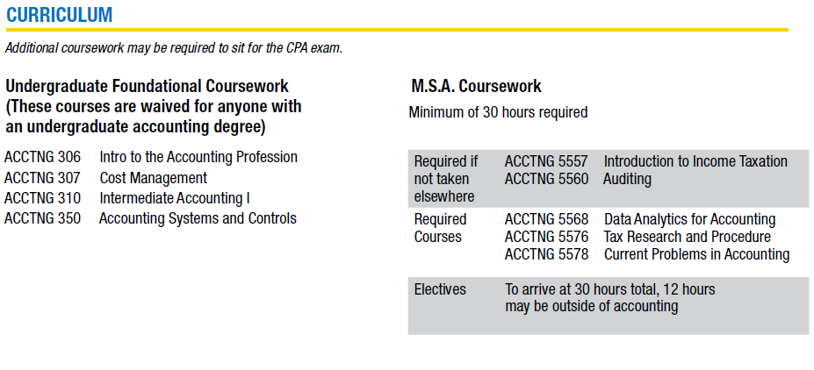
Master of Science in Accounting
Program length varies by undergraduate area of study. Typically 30 – 42 credit hours in duration.

Slide 8
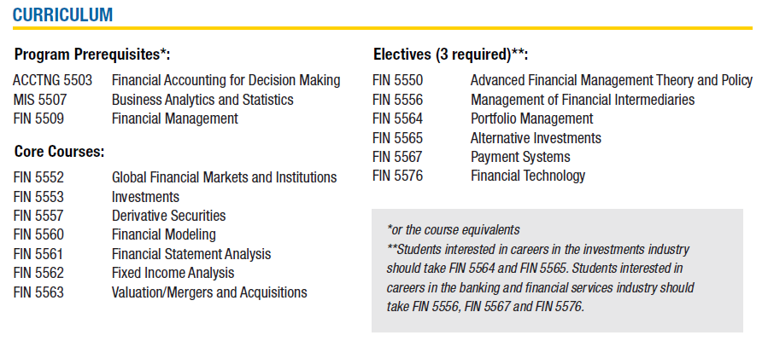
Master of Science in Finance
Program length varies by undergraduate area of study. Typically 30 – 39 credit hours in duration.

Slide 9
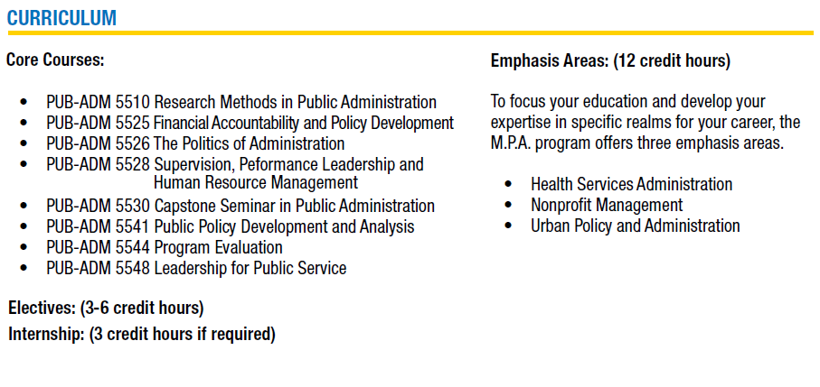
Master of Public Administration

Slide 10
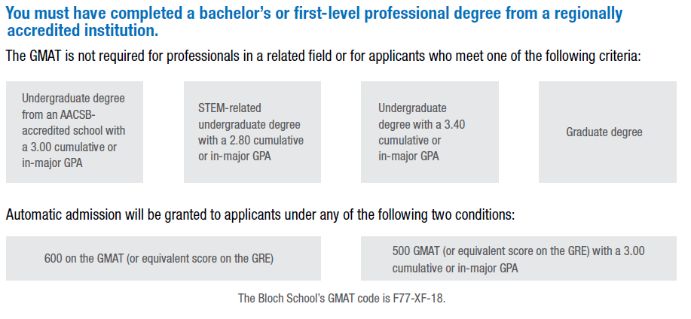
Master of Science in
Entrepreneurial Real Estate

Slide 11

Master of Science in Entrepreneurial Real Estate Highlights

Slide 12
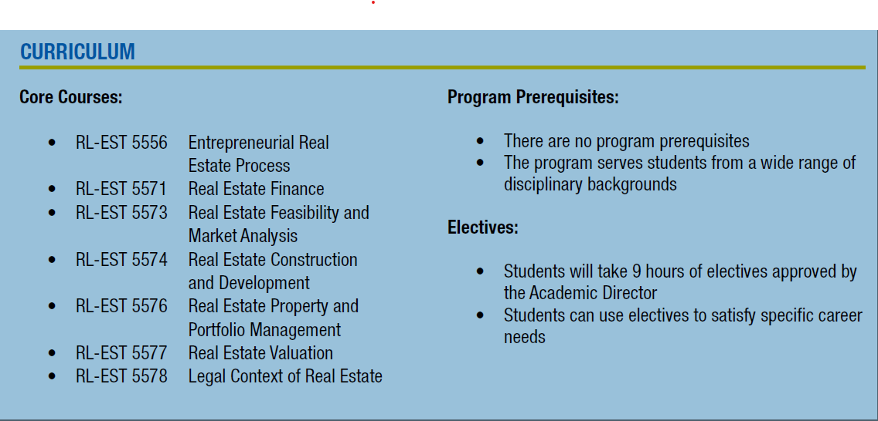
Master of Science in Entrepreneurial Real Estate

Slide 13
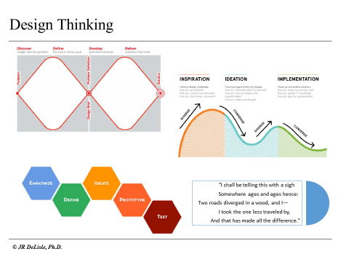
Critical Thinking vs. Design Thinking
Purpose, Trigger
Problem Statement
Theories, Concepts, Assumptions
Information Processing
Conclusion
Research Design: Data Compilation
Execution

Slide 14
Challenges: Critical Thinking in Real Estate
Unique Nature of Discipline
Real estate is different from other disciplines due to its spatial elements and locational fix
Market Inefficiency
Inefficient in terms of information, high transaction costs, and inelastic supply
Group Decision-Making
Real estate decisions involve groups which introduces group dynamics and related issues
Behavioral Science
Real estate is a behavioral science in which transactions and actions are negotiated

Slide 15
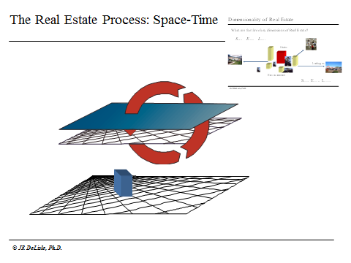
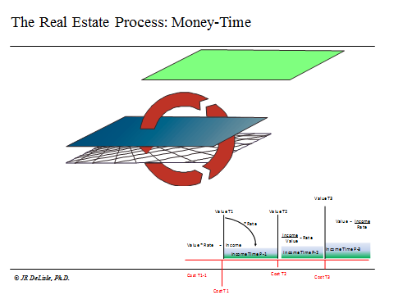
Dual Dimensions of Real Estate
  Artificially delineated space over time with a fixed reference point to the earth…

Slide 16
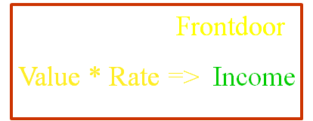
Frontdoor Model: Sequence
TRCm
* Wcc
GIr
NIr
/ NIR
Land
Hard & Soft Costs
NIR = 1 – (Er + Ptx + Vr)
TRCm

Slide 17

Backdoor Model: Reverse Engineered
TRCj
/ Wcc
GIm
/ NIR
NIm
Land
NIR = 1 – (Er + Ptx + Vr)
Hard & Soft Costs
TRCj

Slide 18
Real Estate Risk Management
Information & Analysis
Unforeseen Changes
Changes in Real Estate Law
Inaccurate Data
Inadequate Information
Invalid or Unreliable Predictive Models
Other Regulatory Changes
Changes in Competitive Environment
Other Changes
Lack of Understanding of Market Fundamentals

Slide 19
Alternative Approaches to Risk Management
Constraining Risks . .
Avoid
Pricing Risks . . .
Risk Premium
Diversification caps
Insurance
Transfer
Hedging
Reduce uncertainty
Validate Data
Improve information
Enhance models
Understand market
Monitor markets
Track legal/political
Reducing Risks . . .
Due diligence
Enhance credit
Cross collateralize

Slide 20
Positions of Key Participants in Real Estate
Space Users
Space Producers
Space Facilitators

Slide 21
Real Estate as a Behavioral Science: Key Concepts
Perception
The TINR Principle
Market Segmentation
The "Usual Suspects"
Rationale Behavior
Importance of Empathy
Involvement & Complexity
High vs. Low Involvement
Quantitative vs. Qualitative Analyses
Subdividing Players into Homogeneous Sets
Drivers and Decision Making
Enduring vs. Situational

Slide 22
3-Cs of Real Estate Value: Create, Control and Capture
Creating
Controlling
Capturing
  Site Assemblage
  Asset Assemblage
  Entitlement
  Land Development
  Development
  Leasing/Stabilization
  Renovation/Rehab
  Operations Management
  Rent Roll Management
  AssetProperty Management
  Defensive Capital
  Finance
  Recapitalize
  Transfer Interests
  Disposition

Slide 23
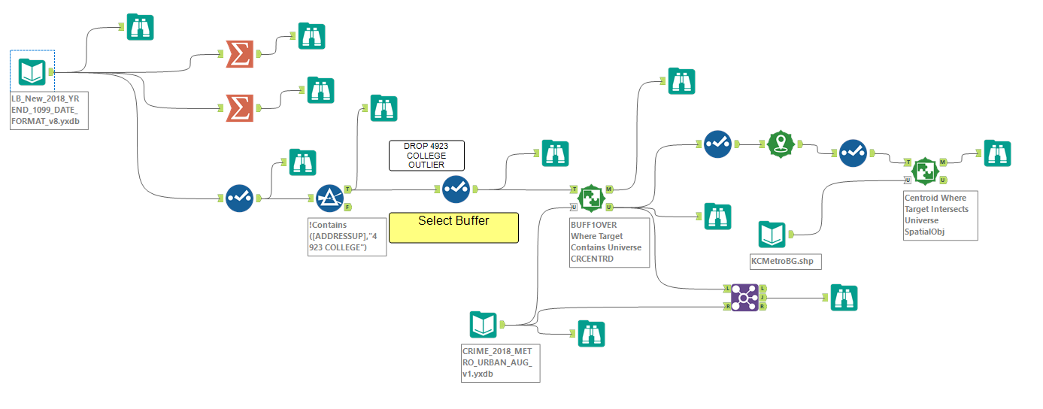
Technology and Real Estate

Slide 24
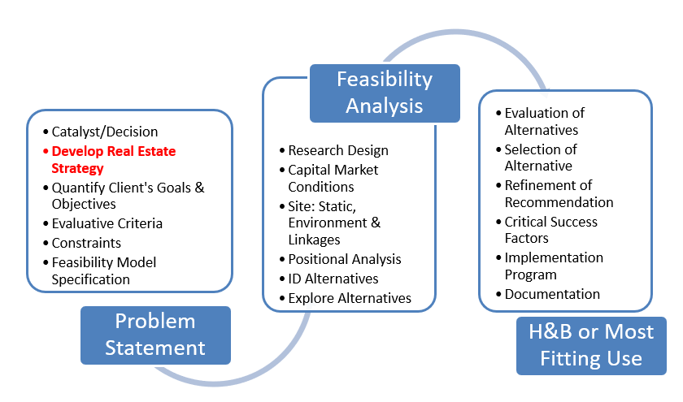
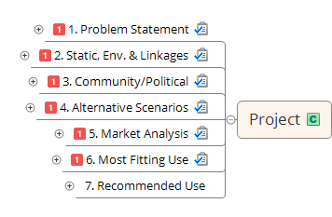
Real Estate Process

Slide 25
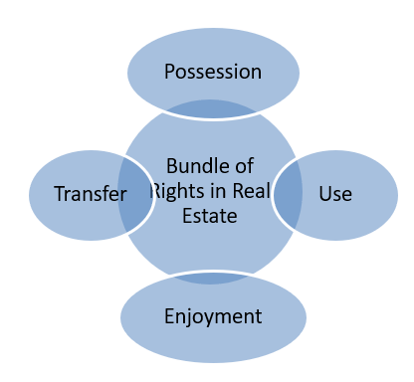
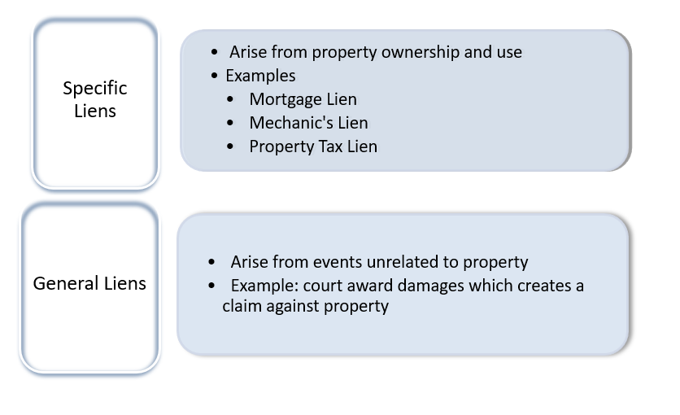
Real Estate Law

Slide 26
Appraisal: A Life Cycle Approach to Value
Appraisal: What it is
Feasibility:
What it Should Be
Planning, Acquisition/
Development Stage
Operations Stage
Leasing
Disposition/
Reposition Stage
Renovation/Rehab
Assembling Land
Using Incentive programs
Developing Buildings
Repositioning
Financing
Changing Entitlements: Re-zoning
Obtaining Entitlements
Pre-leasing
Asset Assemblage
Refinancing
Financing

Slide 27
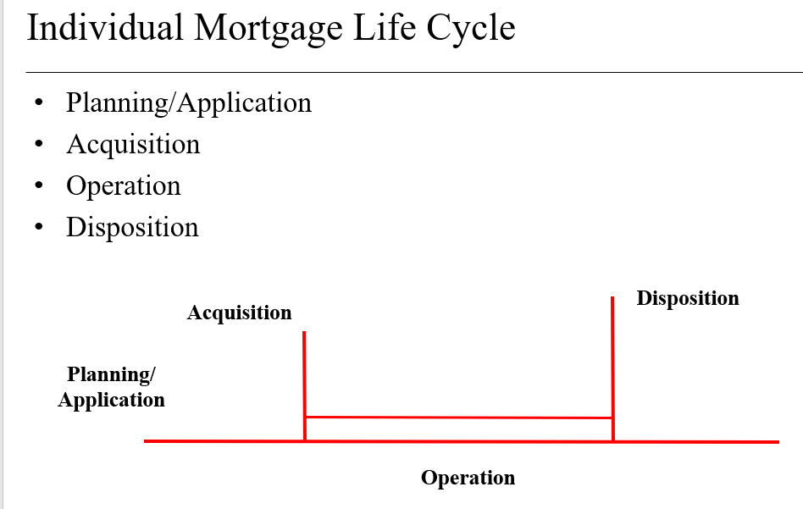
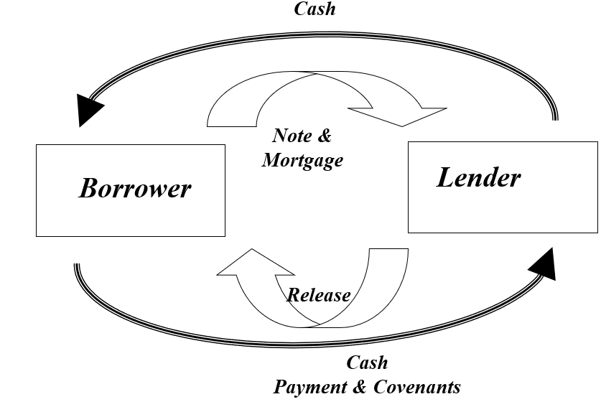
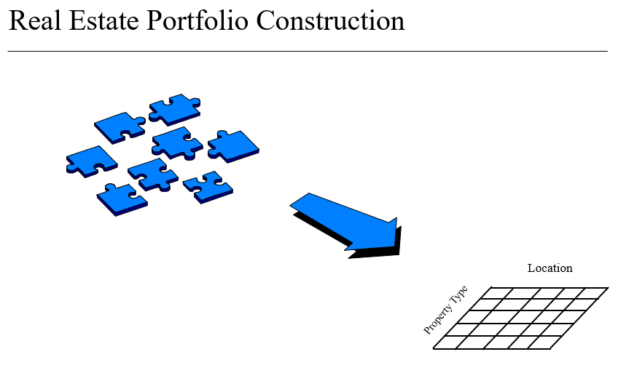
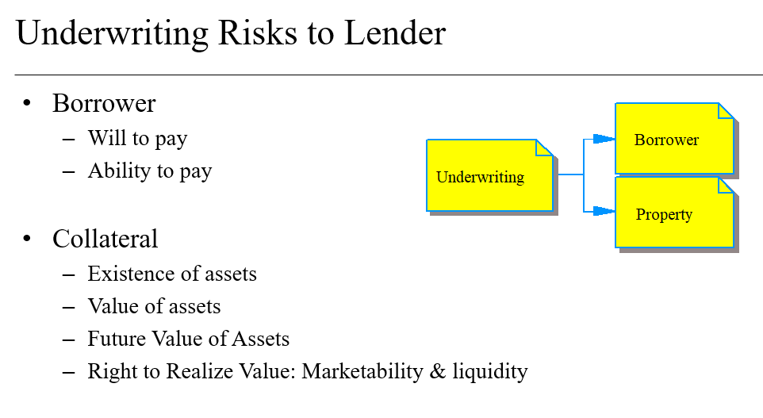
Real Estate Finance

Slide 28
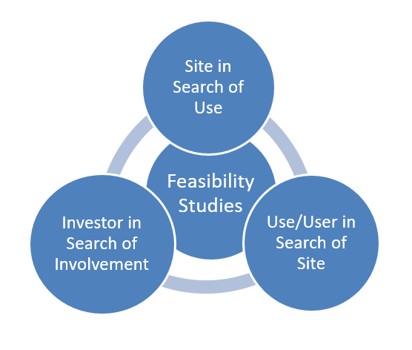
Real Estate Feasibility
Client orientation
Reasonable likelihood
Explicit objectives
Alternative courses of action
Context of specific constraints
Resource Limitations

Slide 29
Real Estate Development
Property and Portfolio Management
Project Risks
  Construction quality
  Development cost
  Development timing
  Development Financing
Market Risks
  Spatial
    Changing demand
    Changing competition
  Capital/Financing
    Changing cost of capital
    Changing access to capital

Slide 30
Application for MSA, MSERE, MSF and MPA
Application Portfolio
  Application: www.umkc.edu/apply
  Official Transcripts
  Personal Statement
  Resume

Slide 31
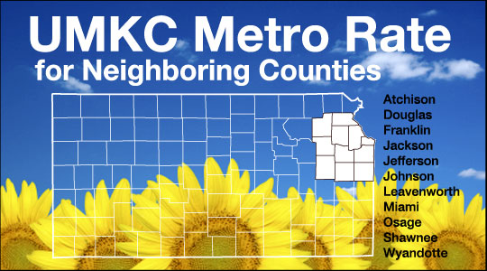
UMKC Metro Rate
The Metro Rate allows undergraduate and graduate Kansas residents of neighboring counties to pay the same rates as Missouri residents

Slide 32
Your Financial Investment
Tuition + fees = approximately $550 per credit hour when you enroll in 6 to 9 credits per semester
  Accelerated PMBA (33 credits): approx. $18,500 total tuition + fees
  Professional MBA (39 credits): approx. $21,500 total tuition + fees
MSA, MSF and MSERE Programs:
  30 credit hour programs: approx. $16,500 – additional credit hours may be required based on undergraduate background.
  MPA Program 39 to 42 hour program: approx. $19,500 - $21,000
  Tuition + fees = approximately $500.00 per credit hour

Slide 33
Questions ?
Bloch Admissions Team
  Gene Pegler, peglere@umkc.edu or 816-235-5254
  Antoinette Redmond, redmonda@umkc.edu or 816-235-6856
Real Estate Faculty
  Jim DeLisle, Program Director, Associate Professor, delislej@umkc.edu or 816-235-6288
  Chuck Connely, Director Lewis White Real Estate Center, Associate Teaching Professor, connelyc@umkc.edu or

