Slide 1

Data Analytics to Facilitate Social Entrepreneurship
Presented by:
Jim DeLisle, May 2019
Midwest Symposium on Social Entrepreneurship

Slide 2
Open Data in Real Estate
Federal Government and Other Free Sources
KCMO Open Source Portal

Slide 3
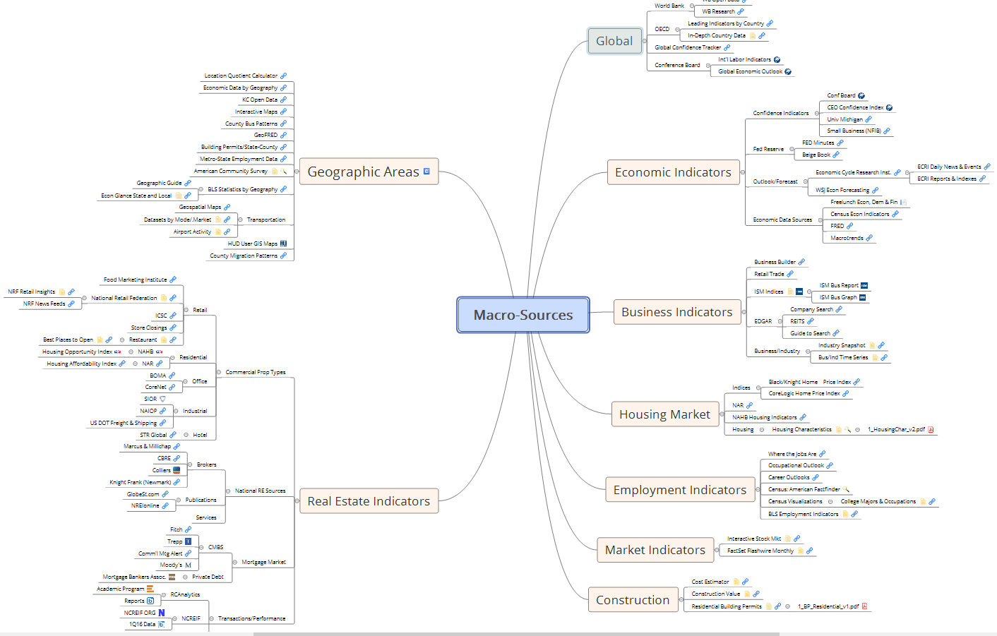
Macro-
Real
Estate
Data
Sources

Slide 4
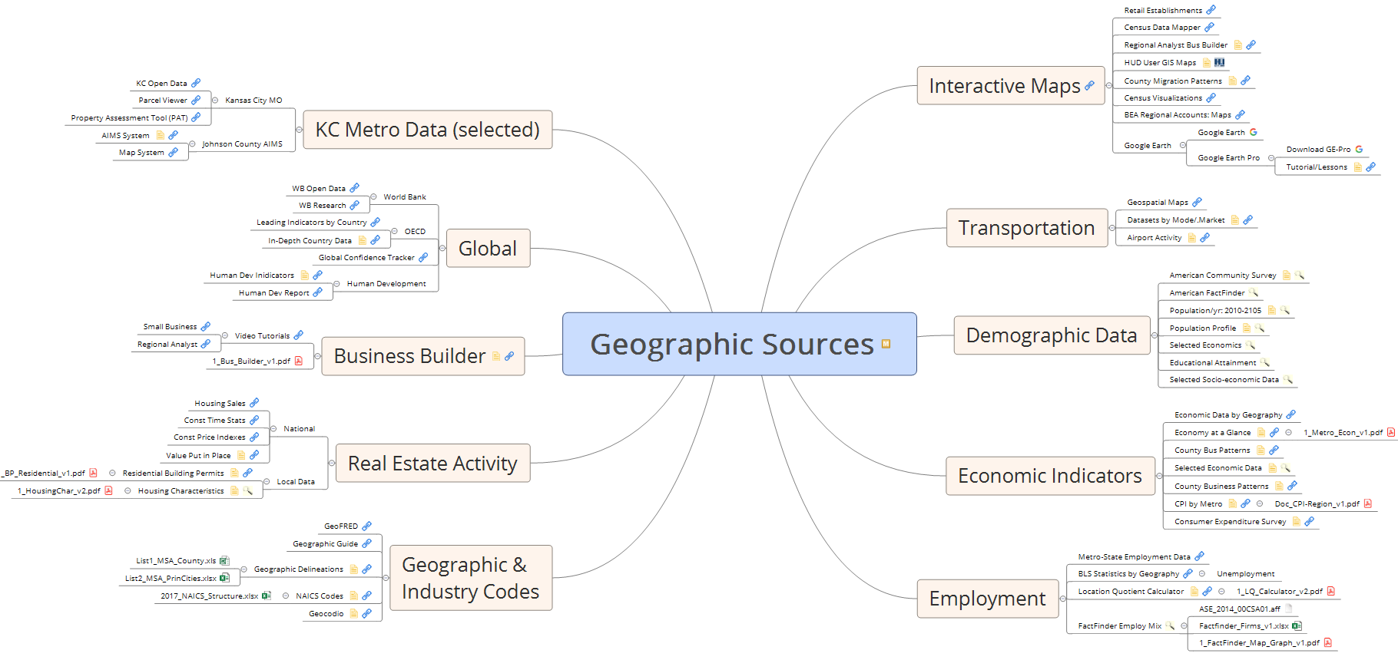
Geographic RE Sources of Data

Slide 5
Open Datasets for Exploration of Environs
Datasets
  Land Bank: the inventory and status of acquired and disposed residential improved properties
  Crime: incident reports compiled by the KCPD that feeds into the FBI’s Criminal Justice Information System (CJIS) data system with IBRS codes.
  311 Requests: citizen-generated complaints or queries mapped to individual properties reported by category and type.
  Property Violations: property-specific violations that recorded by KC-MO in its monitoring and compliance system related to individual properties.
  Building Permits: a range of property-specific building activities including renovations, expansions, new construction, and demolitions.
Temporal Frame
  Datasets: 2010-2018
  Land Bank: 2013-2018
  Abandoned Housing Act Cases: 2016-2018

Slide 6
Classification of Datasets
PVs: 481
CRIMES: 60
311 Requests: 356
Against Groups

Slide 7
What do Stakeholders Want
Information not data
Impact Analysis: How to Make a Difference

Slide 8
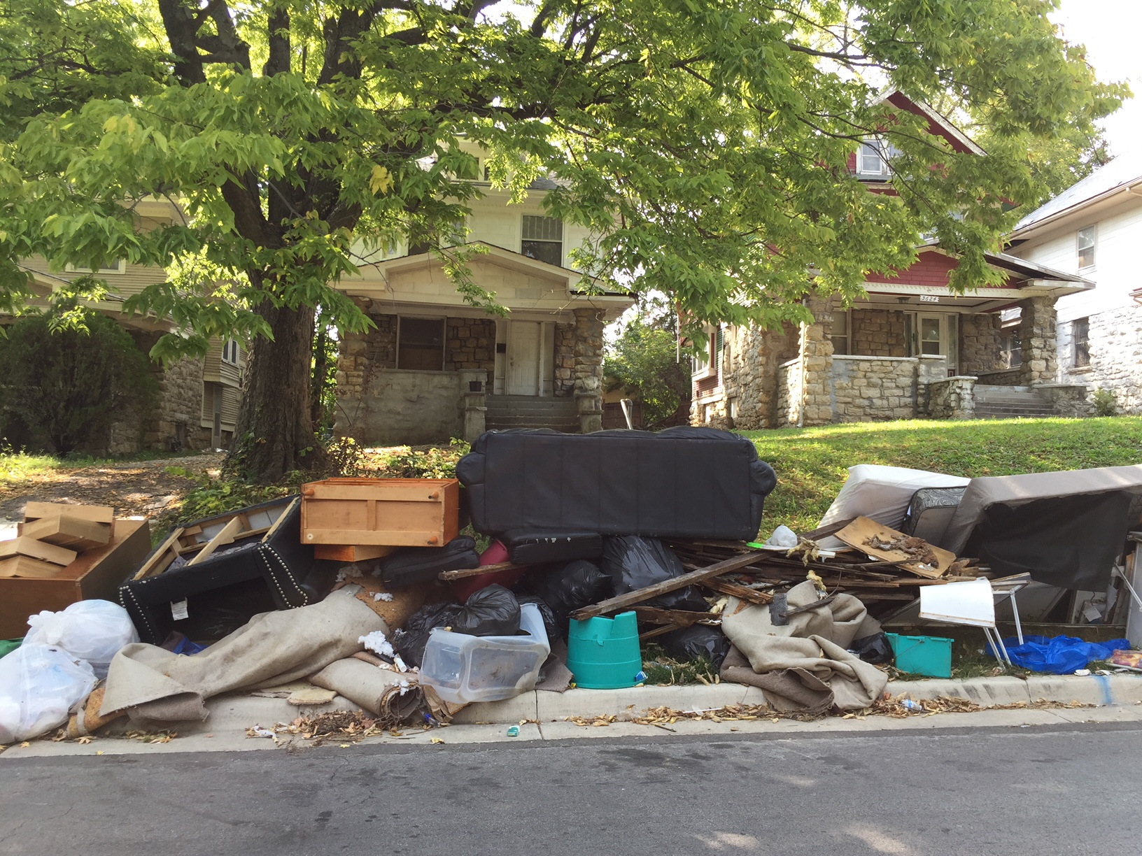
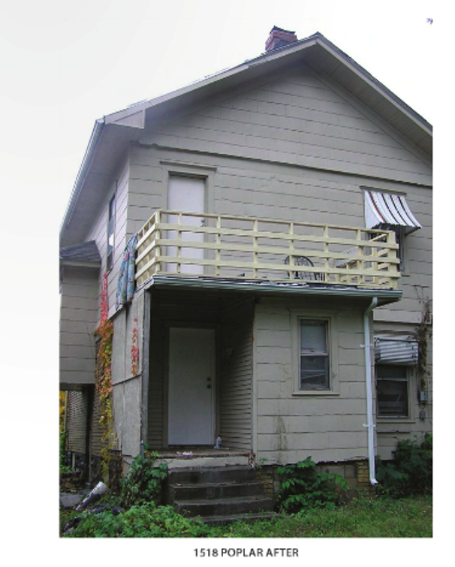
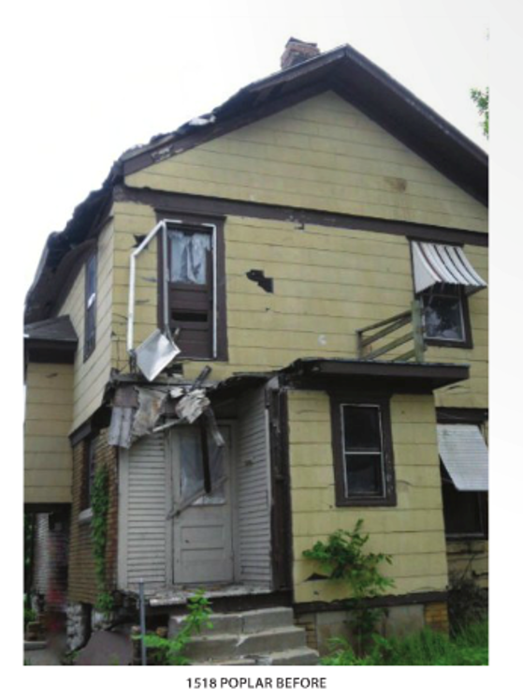
Open Data: Abandonment Housing & Environs
Abandonment/Sale = f(Property & Place)
Place = f(Property & Environ Conditions)
Crime
311 Call Requests
Property Violations
Building Permits
Crime
311 Call Requests
Property Violations
Building Permits
Crime
311 Call Requests
Property Violations
Building Permits
Pre-Abandonment
Abandonment
Sale
Post-Sale

Slide 9
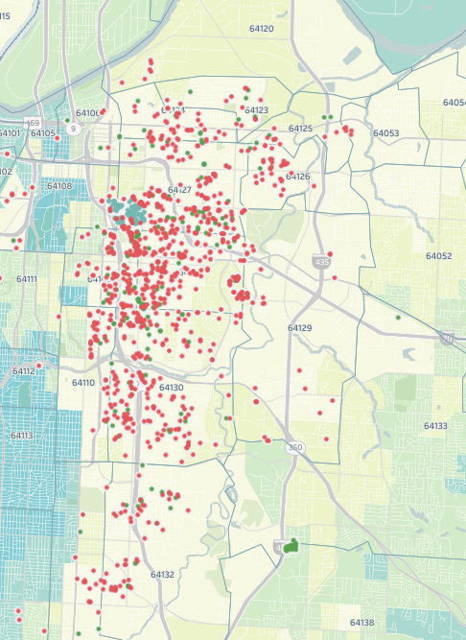
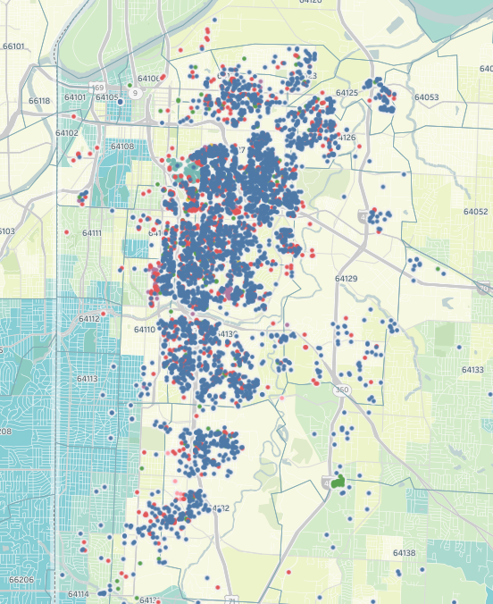
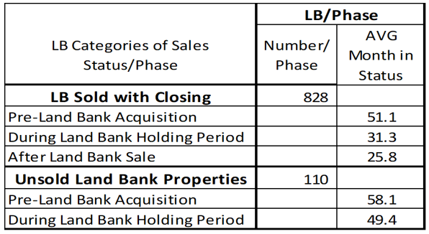
Application 1: Land Bank States
(Before, During & After)
Sold Land Bank
Total Land Bank
Residential Improved LBs

Slide 10
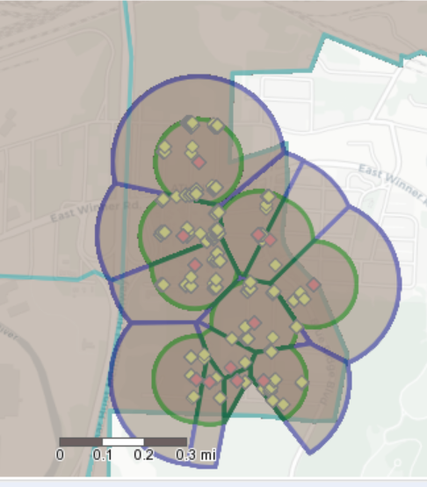
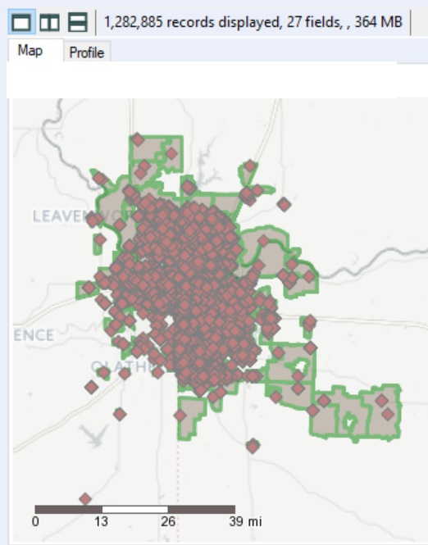
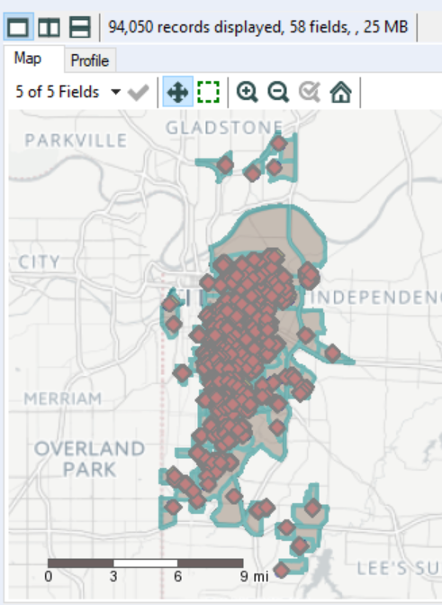
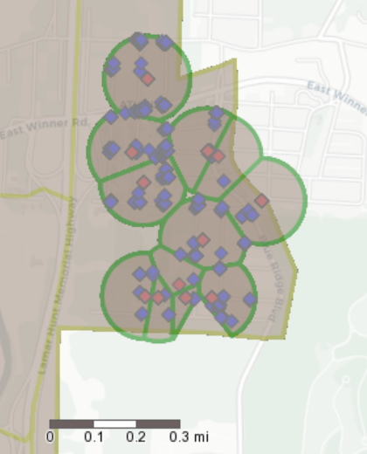
Environs: Land Bank Buffers
Non-overlap buffers
1,094 Land Bank Props:
.1 mile buffers
1.2m Metro KC

Slide 11
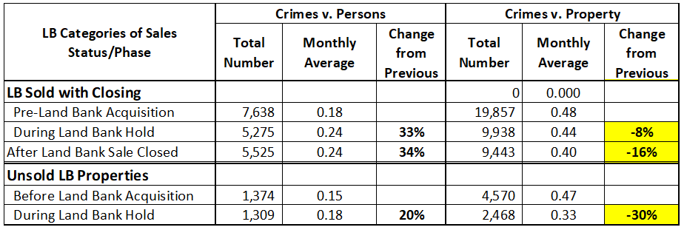
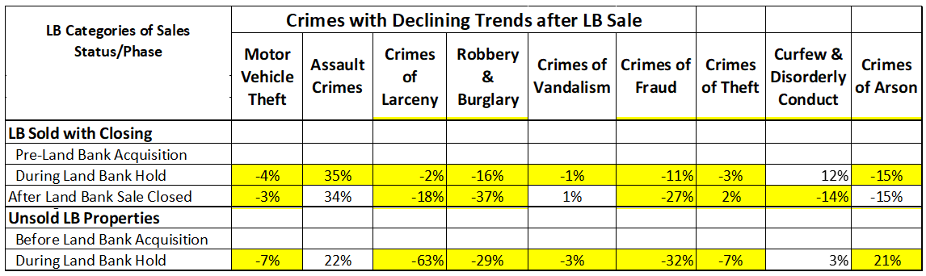
Crimes with Declining Trends After LB Sale

Slide 12
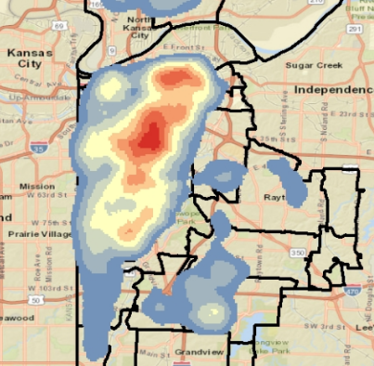
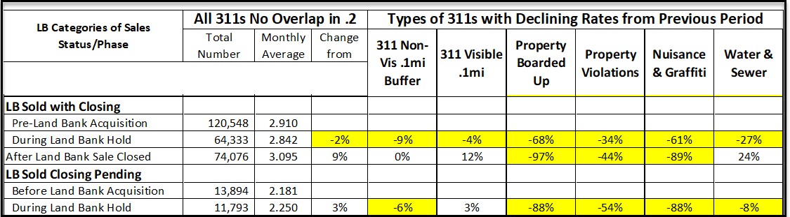
311s with Declining Trends
After LB Sale

Slide 13
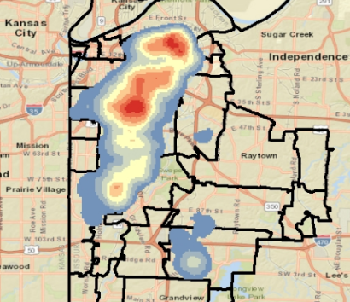
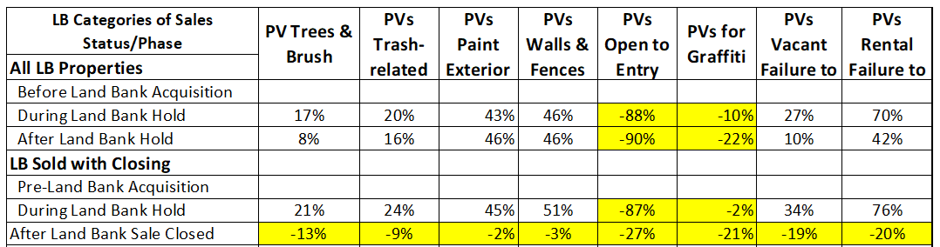
PVs with Declining Trends
After LB Sale

Slide 14
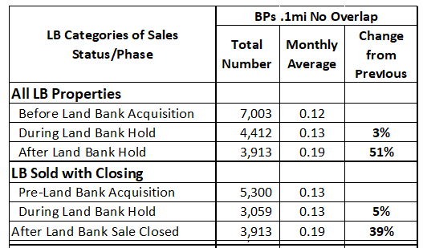
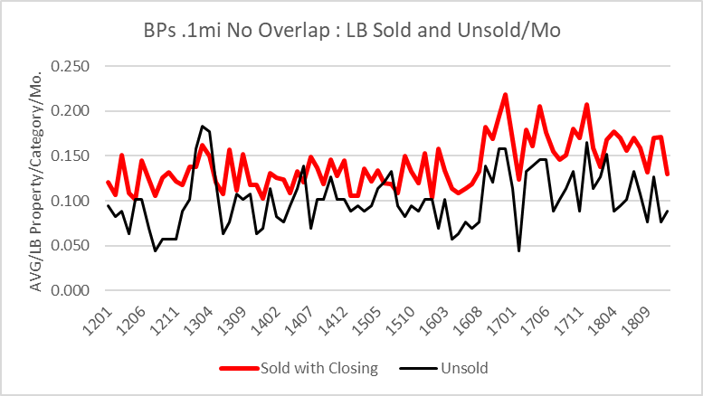
Building Permit Trends: Land Bank Buffers

Slide 15
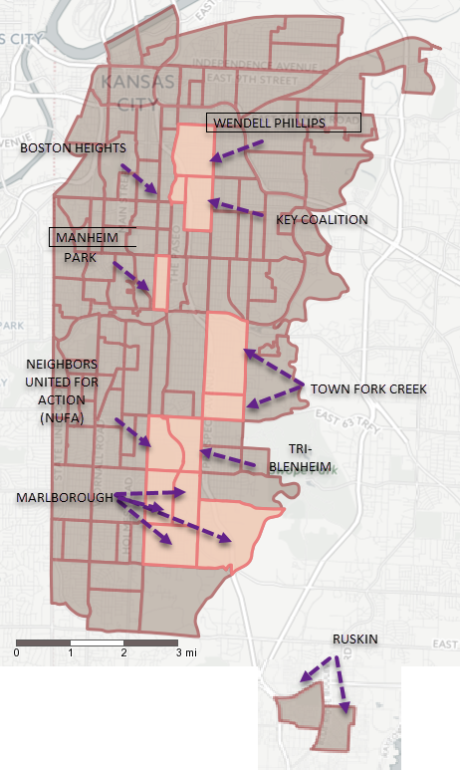
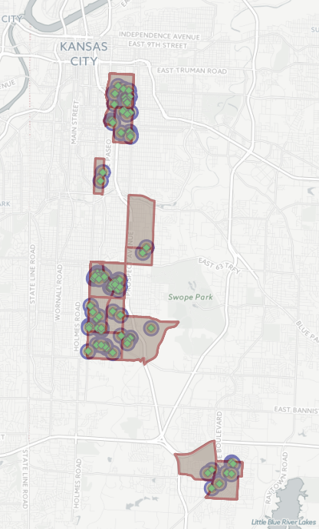
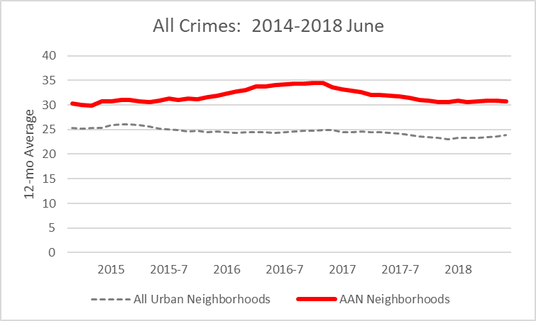
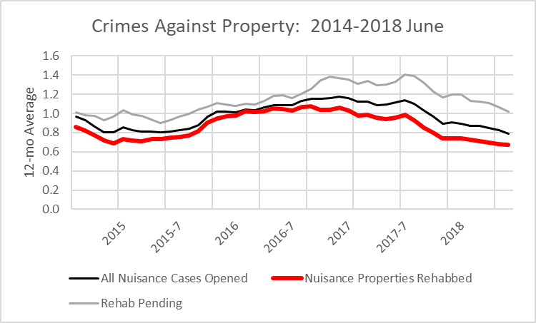
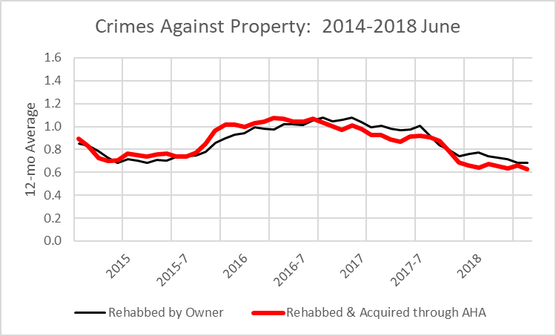
Application 2: Abandoned
Housing Act Interventions
Neighborhoods
Buffers
Abandoned Housing Act
Cases
Higher Crime Neighborhoods
Rehab is Key: Owner motivated vs. AHA Intervention
Rehabbing Mattered

Slide 16
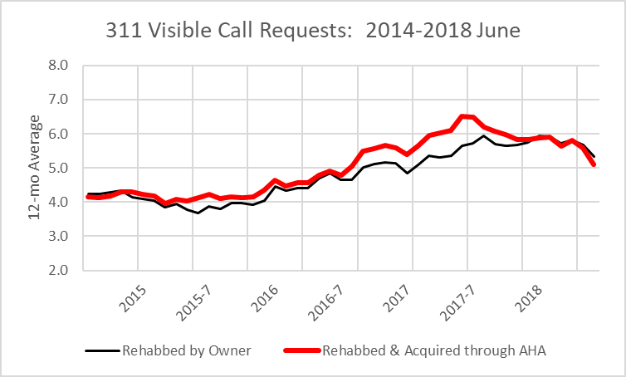
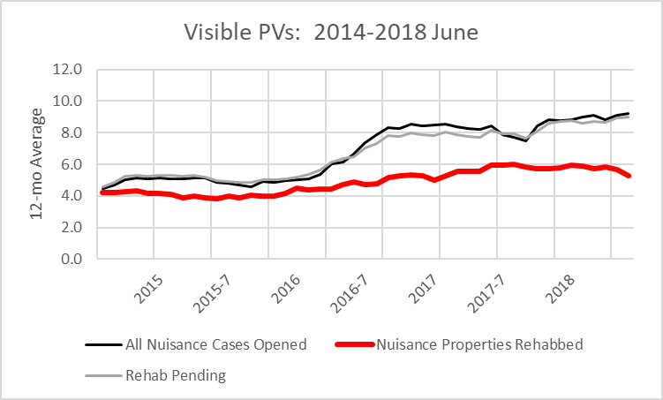
Abandoned Housing Cases:
Interaction w/ 311s and PVs
311 Call Requests
Property Violations
Owner-cured vs. AHA Rehabbed
Rehabbing Mattered

Slide 17
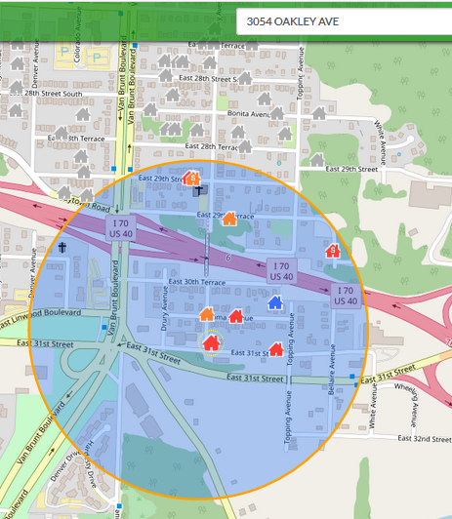
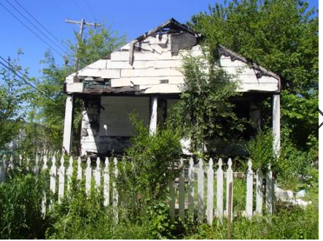
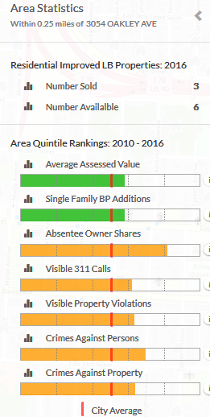
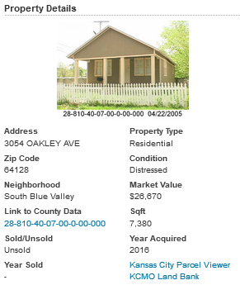
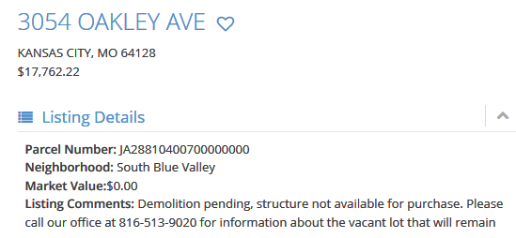
Application 3: v2V-Lb Website for Buyers
v2V-Lb

Slide 18
Tools and Processes
Alteryx
Tableau

Slide 19
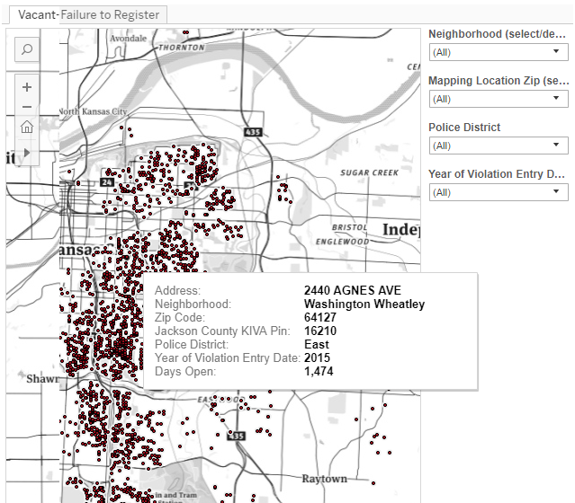
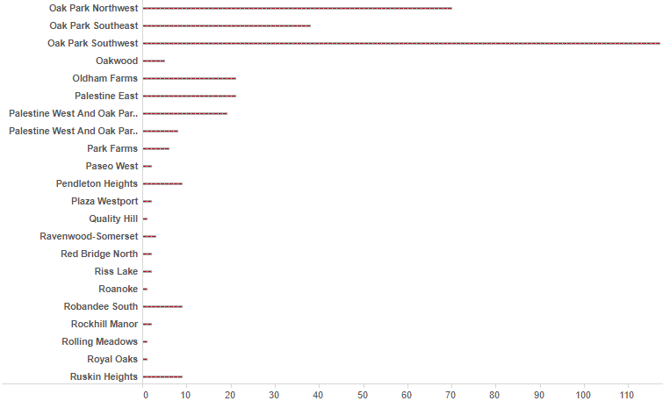
Tableau: KCMO Open Source Feed
Vacant Failure to Register
Filters
Dashboard: Number per Neighborhood
Filter by Year: Trends

Slide 20
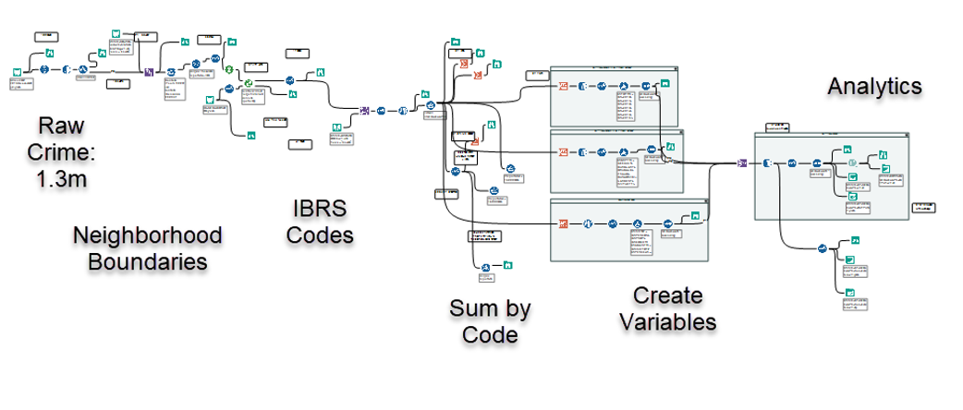
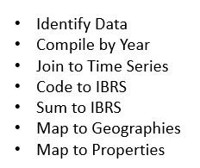
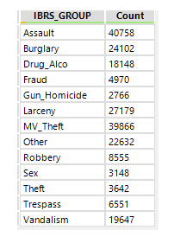
Alteryx: Data Development (Crime)
Step 3: Process
Step 1: Data Development
Step 4: Output
Step 2: Codes

Slide 21
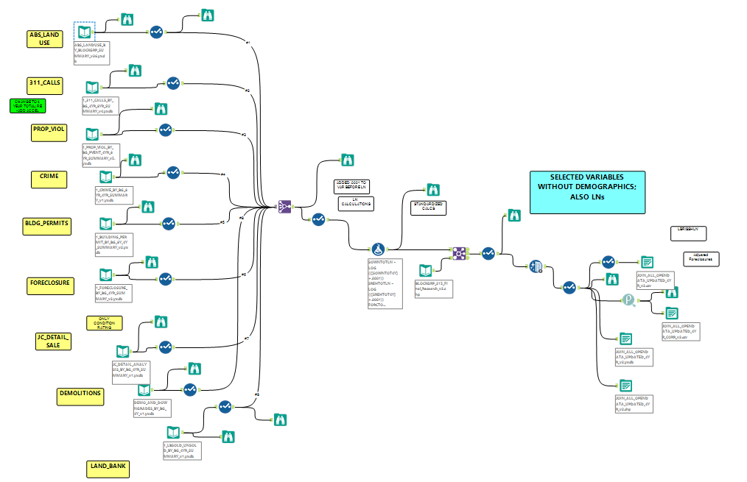
Alteryx: Join All, Maintain & Update
Land Use; Absentee
311 Calls
Prop Violations
Crime Incidents
Building Permits
Foreclosures
Sales
Demolitions
Land Bank

