Slide 1
Lessons Learned in Blended Teaching and Learning Before and After COVID-19 Presented at: 16th European Real Estate Society (ERES) Education Seminar in association with the International Real Estate Society (IRES)
Jim DeLisle, PhD
December 18, 2020
delislej@umkc.edu

Slide 2
Presentation Preview
Format
Original presentation in XMind 8
Converted to PowerPoint for Documentation
Topics
Real Estate Education
Space-time/Money-time scope
Free Resources for Teachers

Slide 3
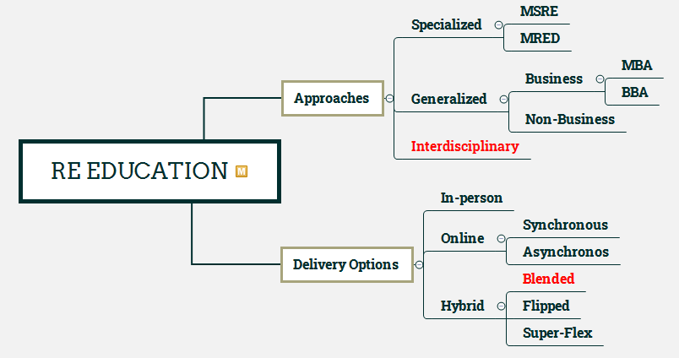
Educational Focus
Approach: Interdisciplinary real estate education
Delivery Option: Hybrid, blended in-person & on-line

Slide 4
Lessons Learned Scope: Space-time, Money-time, Thinking Time

Slide 5
Space-Time: Real Estate Process
Strategy
Introductory case-based course to raise awareness of the process and expose students to the breadth of inquiry.
Mastery of Concepts in other courses in program.

Slide 6
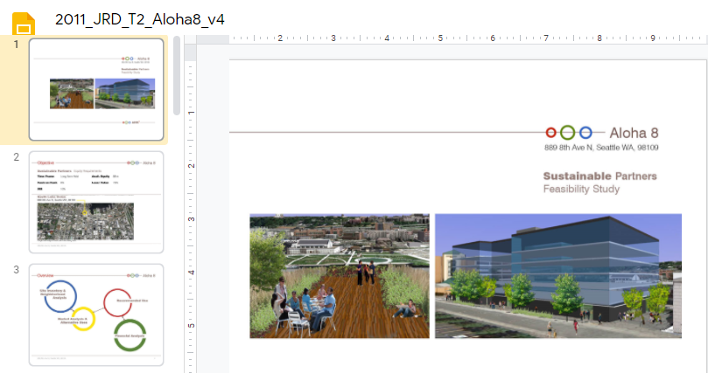
Project Overview: Prior Project Critiques
Students critique prior projects for perspective and orientation. Individual & team-building exercise.

Slide 7
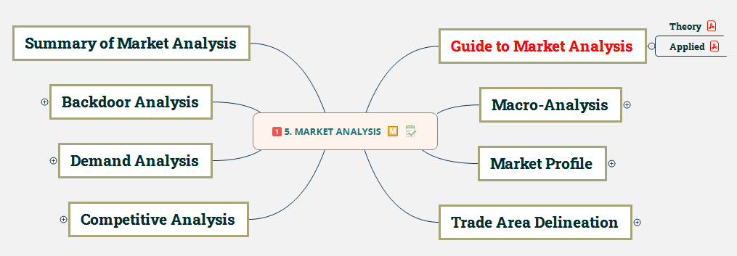
Spatial-Market Analysis
Asynchronous support materials:
Reading Modules: Market Analysis Theory & Application
Tutorial: ESRI Business Analyst, CoStar

Slide 8
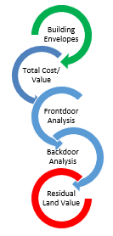
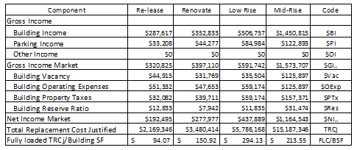
Most Fitting Use Analysis
Experiential & Asynchronous materials:
Reading Module: Most Fitting Use
Integrated Building Envelope, Cost & FD/BD Models

Slide 9
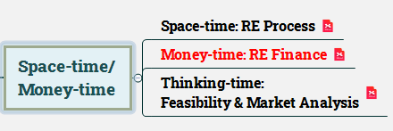
Money-Time: Real Estate Finance
Experiential & Asynchronous materials:
Reading Module: Time Value, Mortgages
Hyperlinked self-paced learning problems
Dynamic formula-based assessment (CANVAS)

Slide 10
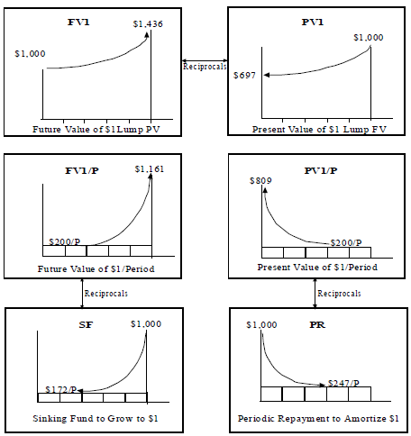
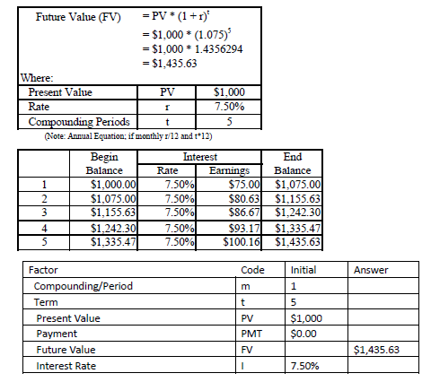
Time Value of Money: Foundational Learning
Conceptual
Mathematical
Excel
Multi-stage, Multi-format Foundation
Conceptual: Objective is to visualize problems
Mathematical/Excel: Solve multi-step problems

Slide 11
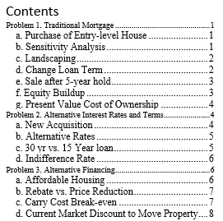
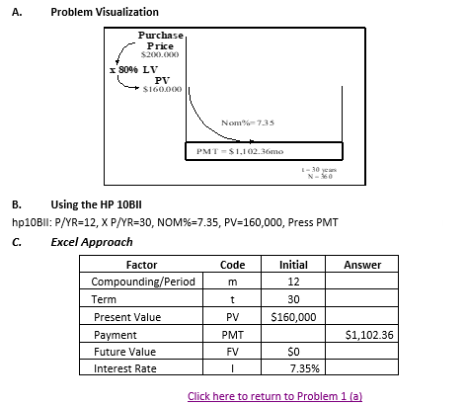
TVM: Experiential Learning
Intro Problems

Slide 12
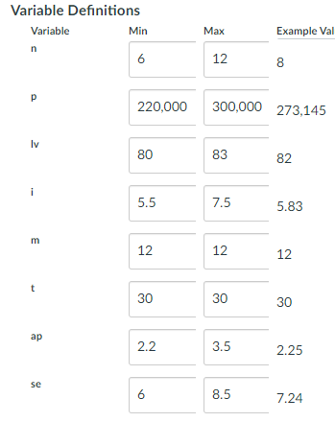
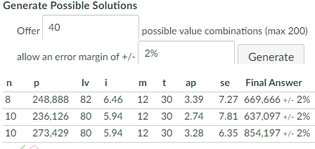
Dynamic Assessment: Formula-based Quizzes
Philosophy: Mastery learning (achievement vs. speed)
Implementation: Calculated Questions in CANVAS, BB
Problem Statement - Vector of inputs - Formula Response
Unlimited Attempts: Highest Score is Grade
Problem Statement

Slide 13
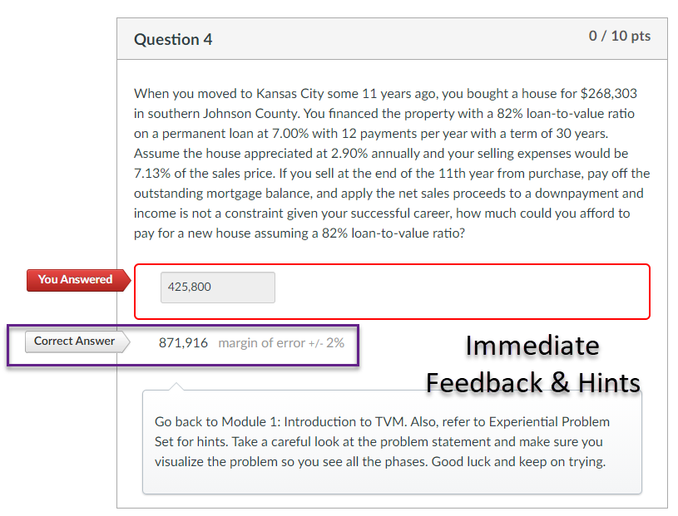
Dynamic Assessment Example
Philosophy: Mastery Learning
Step 1: Student Takes Quiz
Step 2: If correct stop; if wrong
Review Correct Answer
Refer to support materials & hints
Repeat with new inputs and answers
Continue until get desired grade
NOTE: These types of problems are available in Moodle, Blackboard, Canvas and other LMSs.

Slide 14
Thinking-Time: Feasibility & Market Analytics
Philosophy: Real Estate is a Behavioral Science – Thinking is Key
Critical and design thinking is essential to market success
Analytics is key to supporting decision-making
Must have a vision of the future for sustainable decisions

Slide 15
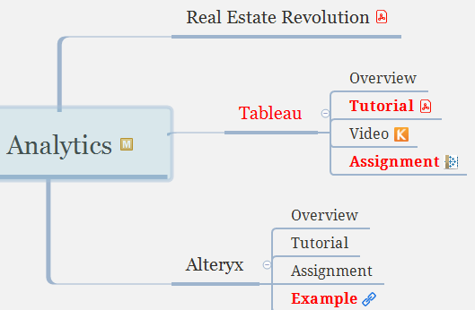
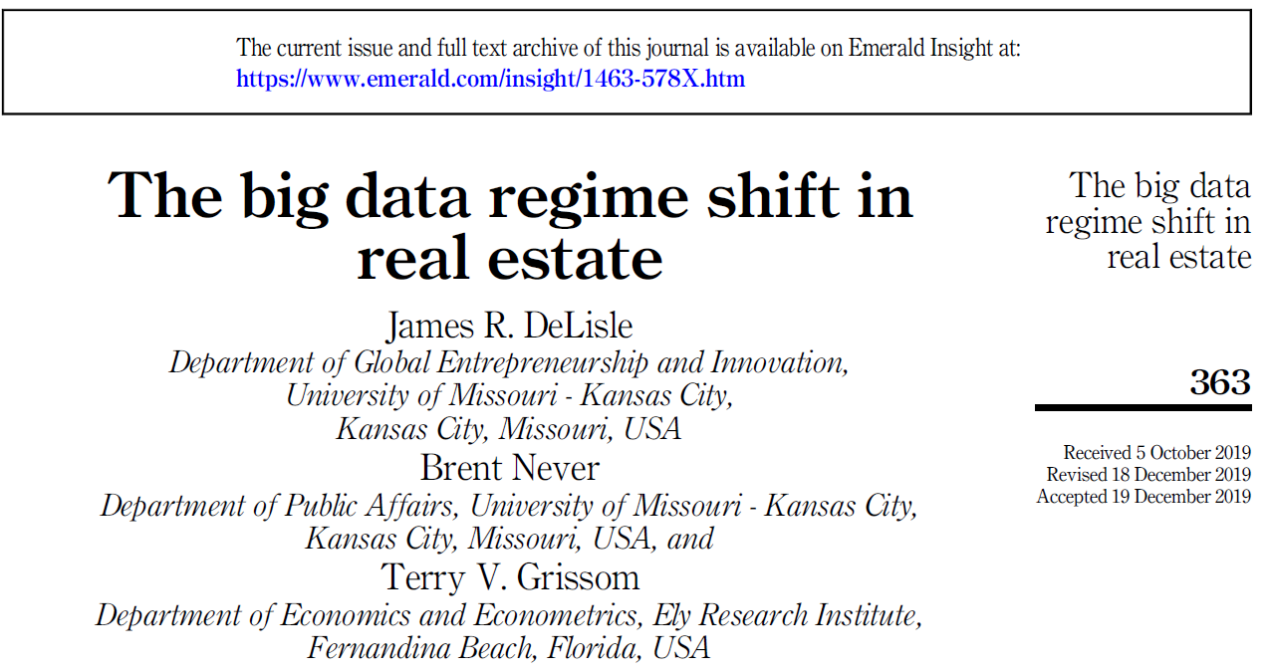
Embedding Analytics in Real Estate Education
Philosophy: Analytics is a means to an end, not an end in itself
Strategy
Raise awareness of the big data/analytics revolution
Integrate analytics into existing courses and problems
Tableau for Visualization
Alteryx for big data and predictive analytics
GIS-based packages for spatial (e.g., ESRI, CoStar, GeoDa)

Slide 16
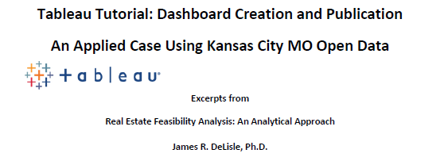
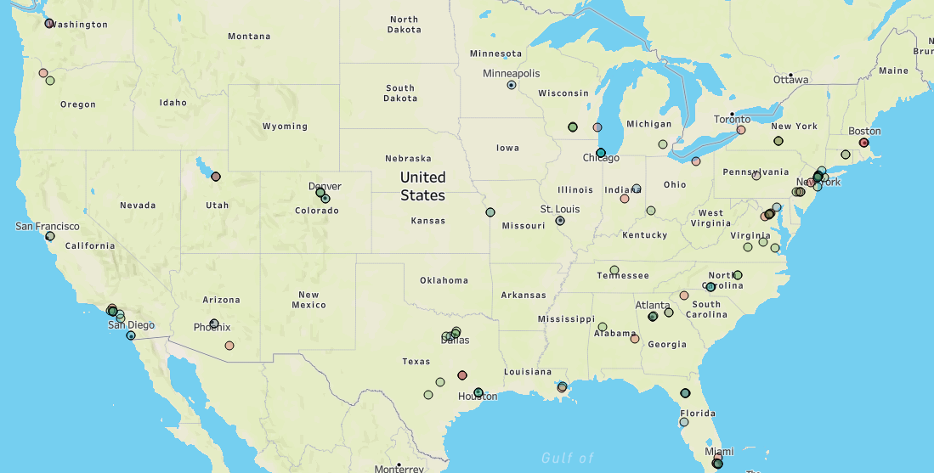
Data Visualization in Real Estate Education: Tableau
Strategy
Prepare asynchronous, customized tutorial materials
Integrate Tableau Visualizations in existing courses/projects
RE Process: Trade Area and Competitive Analysis
RE Finance: Strategic Portfolio Planning
Feasibility & Market Analytics: Spatial Analysis
US Real Estate Degree Programs

Slide 17
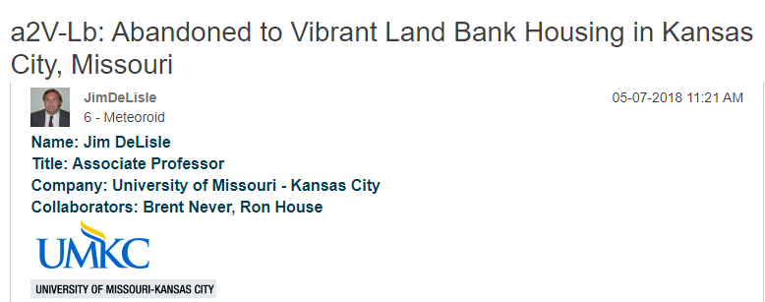
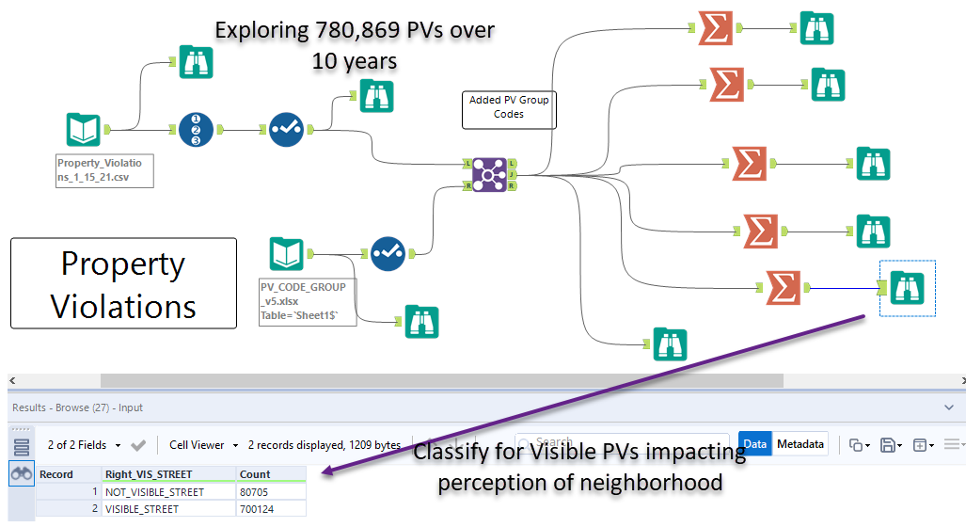
Data Analytics in Real Estate Education: Alteryx
Strategy
Prepare asynchronous, customized tutorial materials
Integrate Alteryx in existing courses/projects
RE Process: big data access to include in analysis
RE Finance: Risk/Return using NCREIF/RCA data
Feasibility & Market Analytics: Spatial & Predictive
Big Data Example for Awareness
Link to a2V-Lb Article

Slide 18
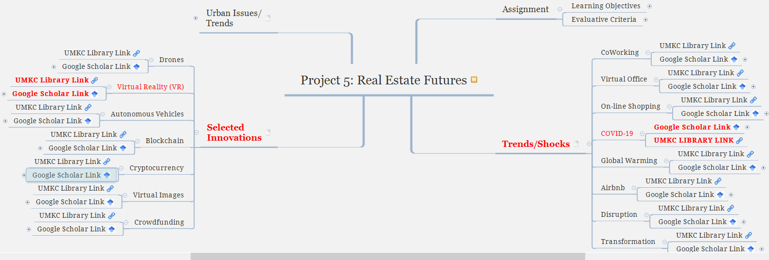
Infusing Future Thinking in Real Estate Education
Philosophy: Analytics is a means to an end, not an end in itself Strategy
Raise awareness of the big data/analytics revolution
Integrate analytics into existing courses and problem)

Slide 19
Free Analytics & Viz Resources for Academics
Alteryx for Good. The "Alteryx for Good Program" provides Alteryx licenses for verified academics, students, and non-profits. By integrating Alteryx in real estate and other academic programs, faculty can provide students with a competitive edge in terms of cutting-edge analytics.
<-- Click for link to Alteryx for Good
Tableau for Teaching. Tableau has established free licenses for students and instructors to encourage adoption of its software. The program requires verification of academic status. The free licenses are available for Tableau, as well as Tableau Prep.
<-- Click for link to Tableau for Teaching
For more packages, examples, and tuturials, go to my personal website for Analytics & Vizzes.

Slide 20
Lessons Learned Recap (aka: Lessons Being Learned)
We are at the beginning of a revolution in real estate and education; there’s so, so much to learn…

