Slide 1

Toward an Understanding of the Nexus of Crime, Place, and Abandoned/Land Bank Buildings
Presented by:
Jim DeLisle, Brent Never, and Terry Grissom
April 13, 2019
American Real Estate Society: Paradise Valley AZ

Slide 2
Problem Statement
Urban Blight & Crime
  A critical problem in many urban markets, especially shrinking
  Complex, multidimensional nature of blight
  Cause and effect
Abandoned Housing
  A Significant Component of the Urban Blight Problem
  Despite some successes, abandoned housing continues to deepen blight
  Land Banks have helped return some properties to productive use
Research Questions
  Are crime rates associated with the decision to abandon housing?
  What other “Place-making” variables affect the abandonment decision?
  Is there some contagion associated with externalities, both positive and negative?
  Does removal of abandoned housing mitigate externalities (e.g., reduce crime)?

Slide 3
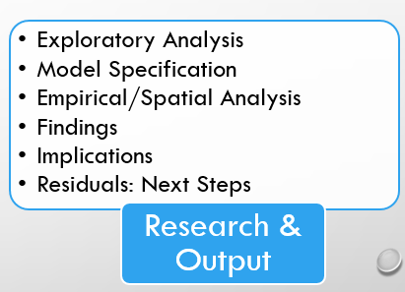
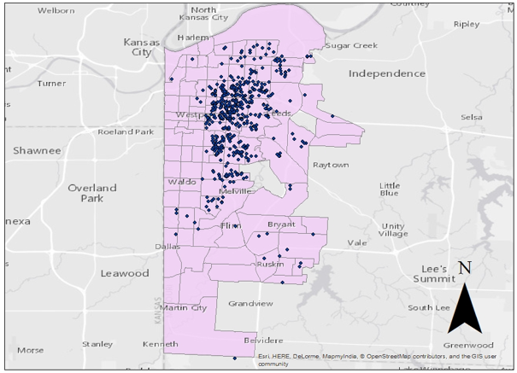
Prior Exploratory Analysis
Data Stratification: Single Family Residential
Sold to Owner-User; Sold to Investor-Landlord
Geography: Urban Core Census Tracts

Slide 4
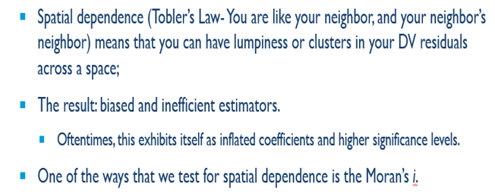
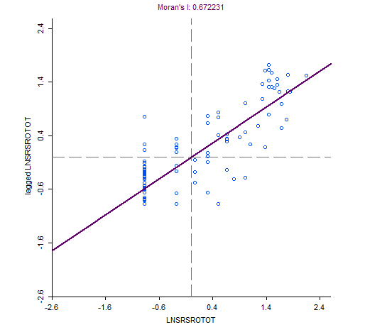
Prior Geospatial Analysis: Spatial Dependence
Moran’s i: .672231

Slide 5
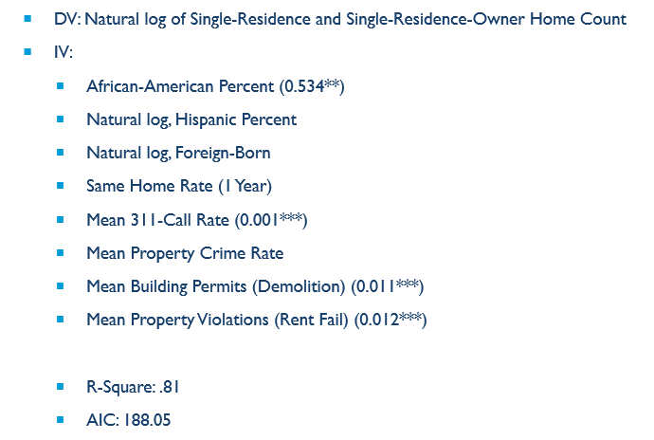
Variables (Model 1: (Full), Spatial Lag)
Good, but at the Census Tract level which is too broad
Strategy
  Shift to proximate areas (Environs)
  Buffers: .1 mile, .2 mile
Implications of Shift in Strategy
  No demographics
  Focus on Environs
  Apply Multi-level analysis

Slide 6
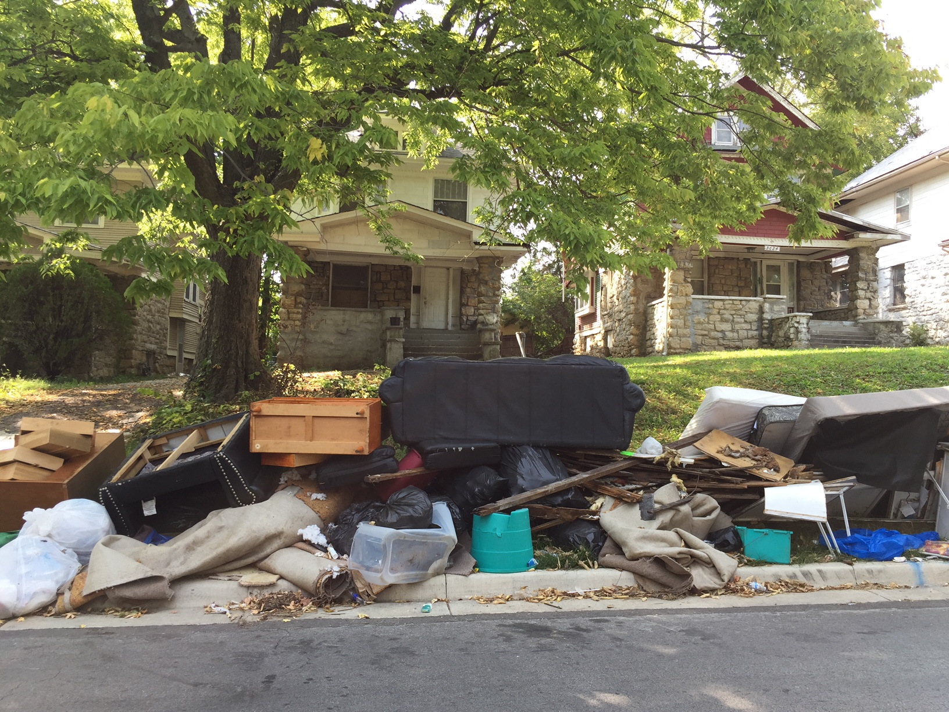
Alternative Design:
Abandonment and Place
Abandonment/Sale = f(Place)
Place = f(Environ Conditions)
311 Call Requests
Property Violations
Building Permits
Crime
Pre-Abandonment
Abandonment
Sale
Post-Sale

Slide 7
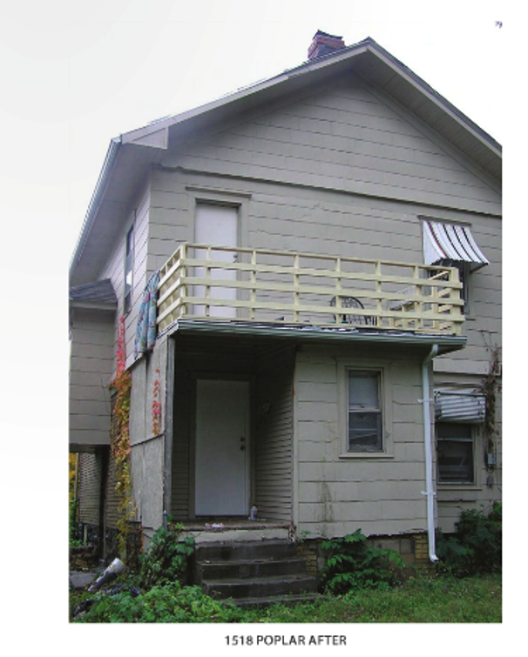
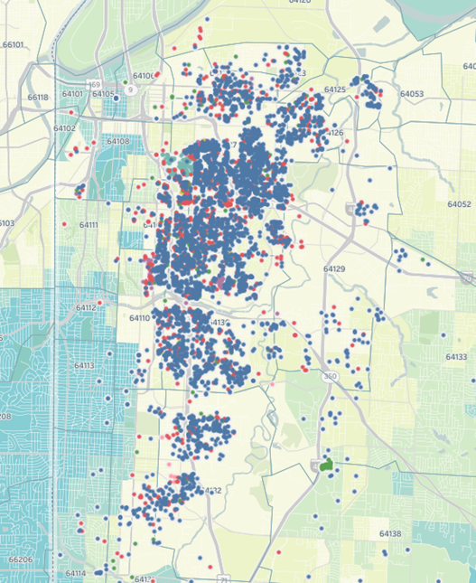
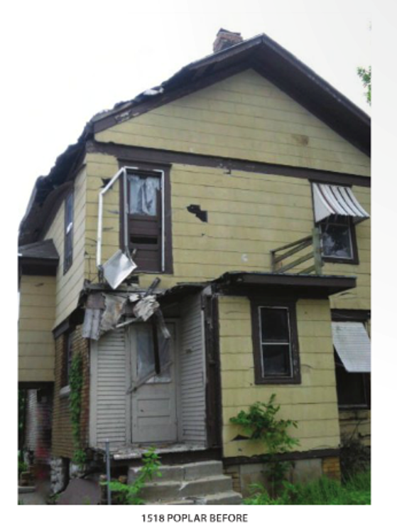
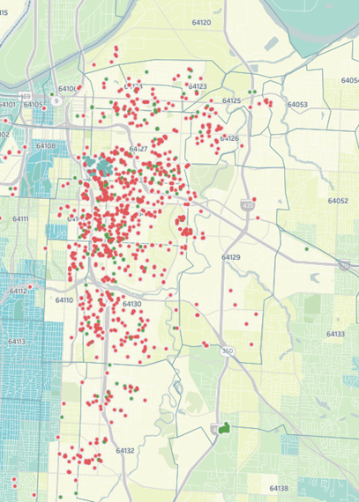
Land Bank Properties: Before, During & After
Owned
After
* population so significance tests not important
Sold
Before

Slide 8

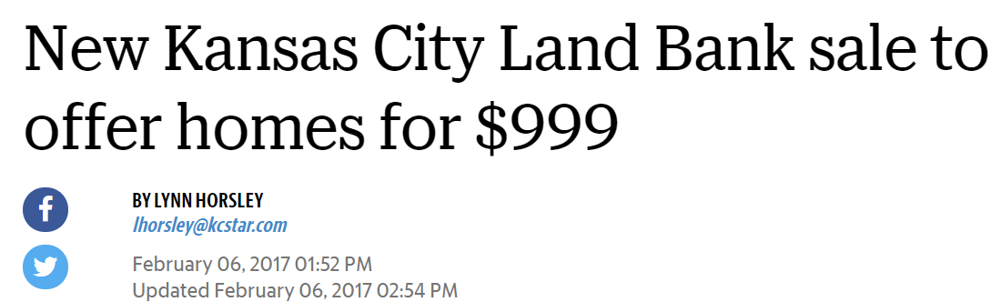
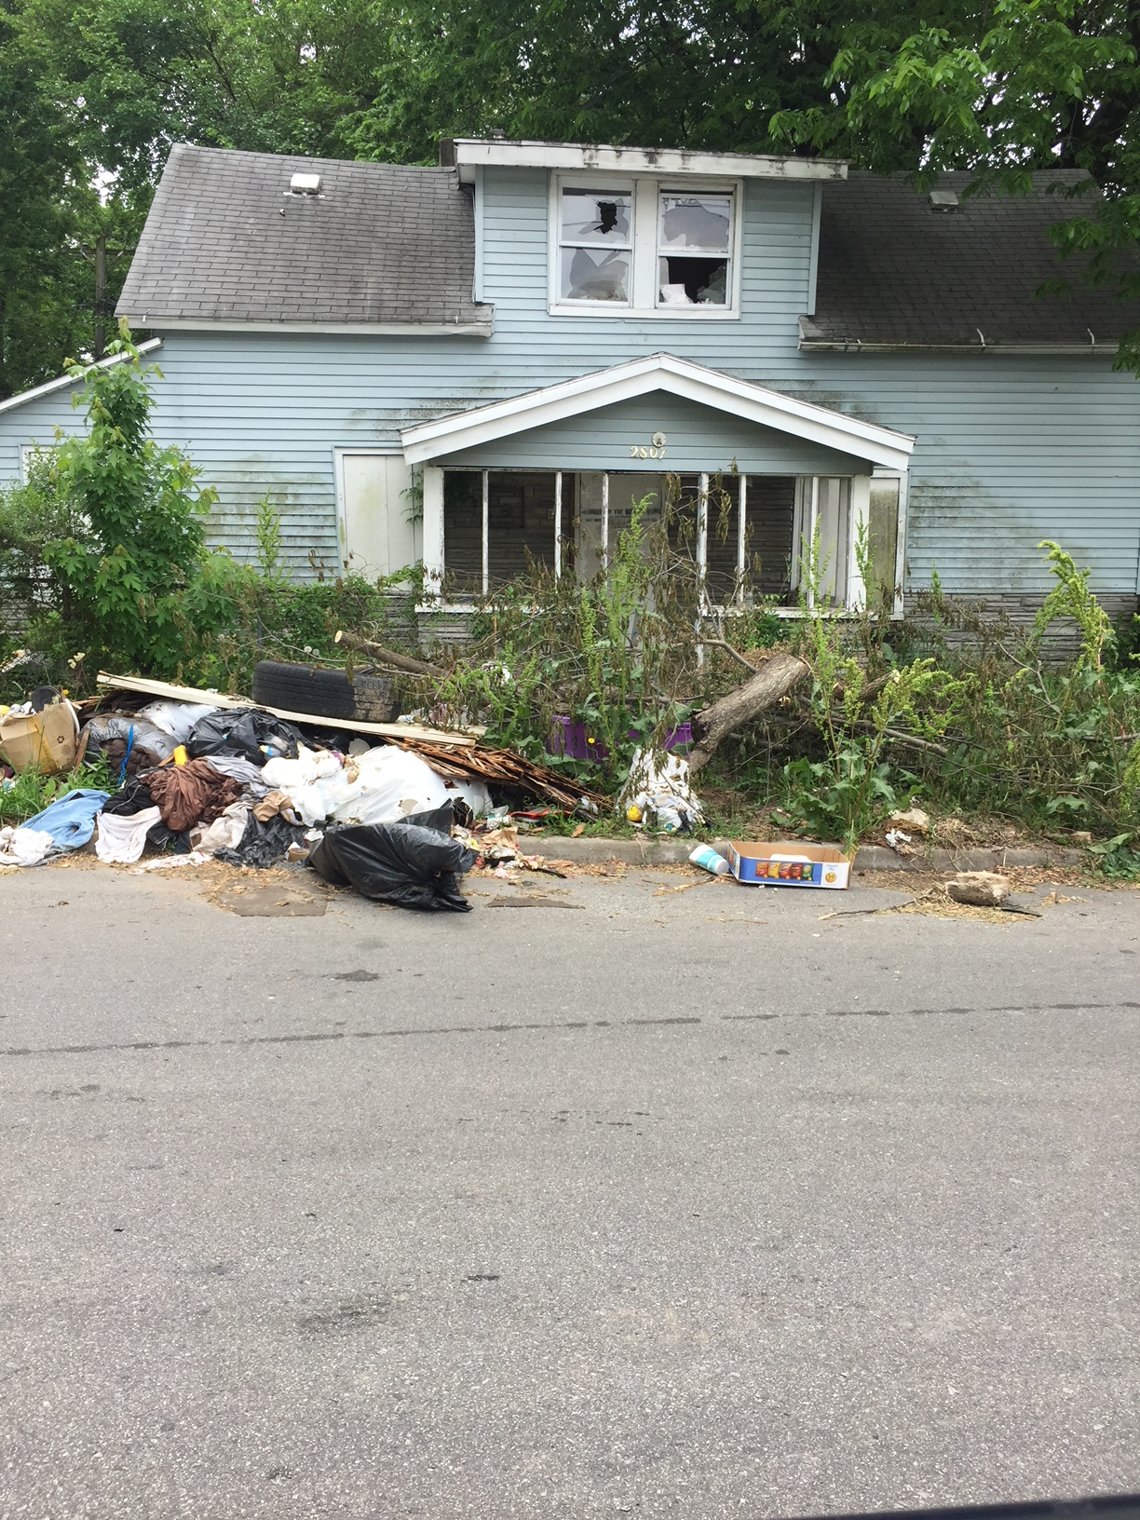
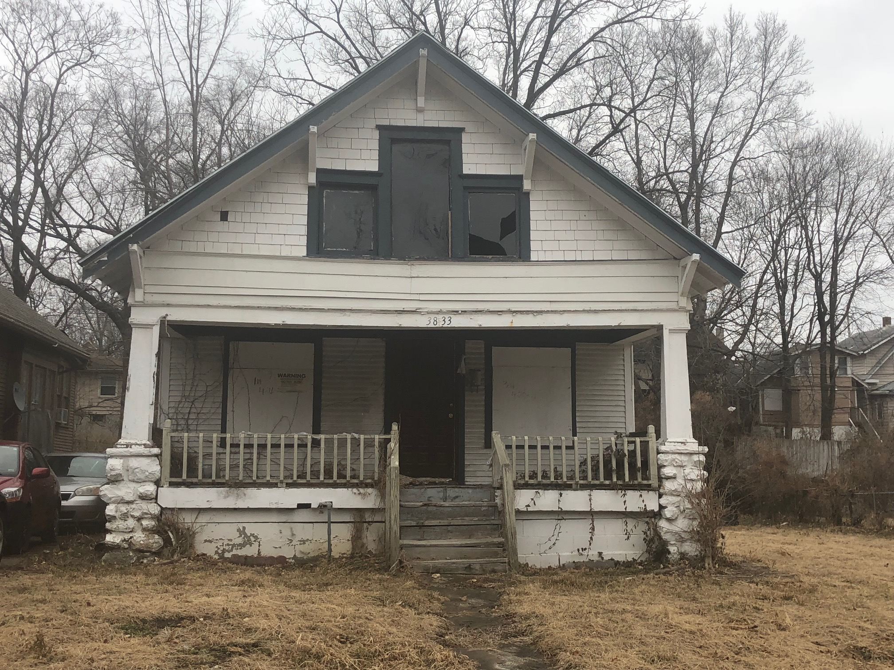
“$1 House” & “$999” Land Bank Programs
Scattered: Dangerous Buildings
Geographically Focused
The Kansas City Star

Slide 9
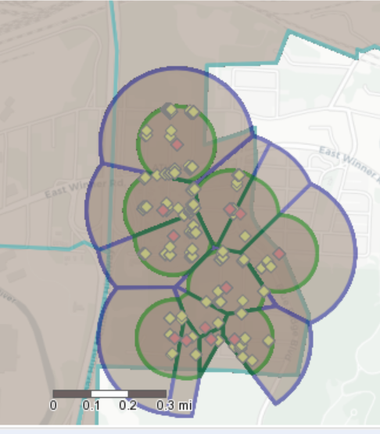
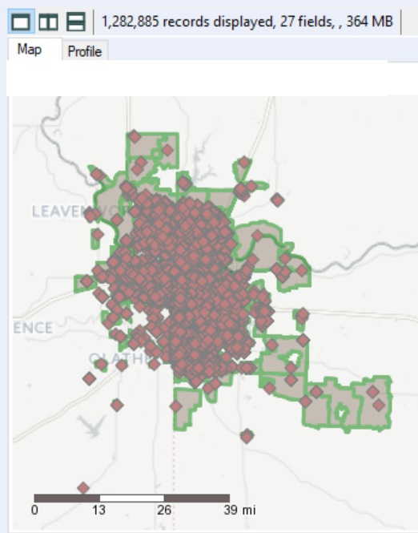
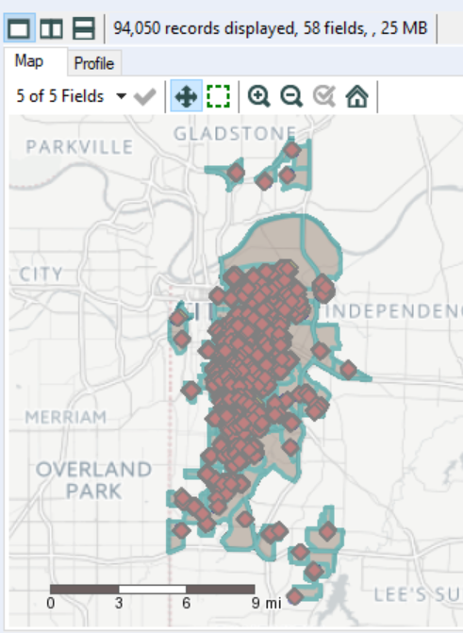
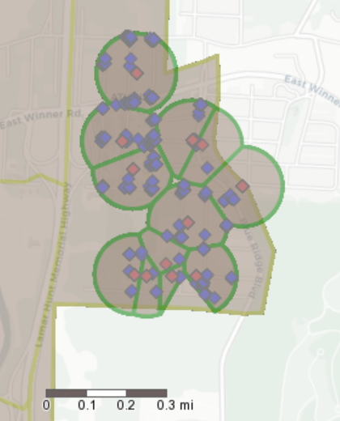
Incidents and Spatial Buffers
94k .1 mile buffers
1.2m Metro KC

Slide 10
Datasets for Analysis
Land Bank: the inventory and status of acquired and disposed residential improved properties
311 Requests: citizen-generated complaints or queries mapped to individual properties reported by category and type.
Property Violations: property-specific violations that recorded by KC-MO in its monitoring and compliance system related to individual properties.
Building Permits: a range of property-specific building activities including renovations, expansions, new construction, and demolitions.
Crime: incident reports compiled by the KCPD that feeds into the FBI’s Criminal Justice Information System (CJIS) data system with IBRS codes.

Slide 11
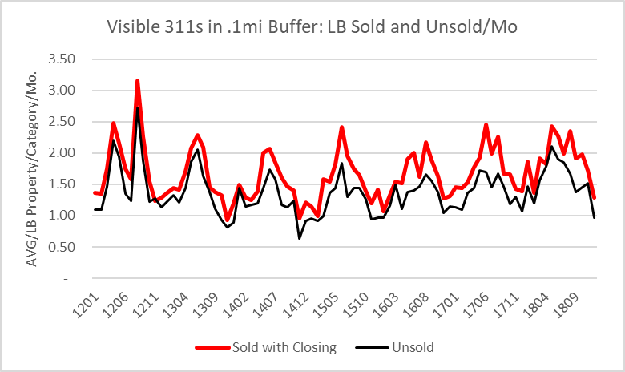
311 Request Environs

Slide 12
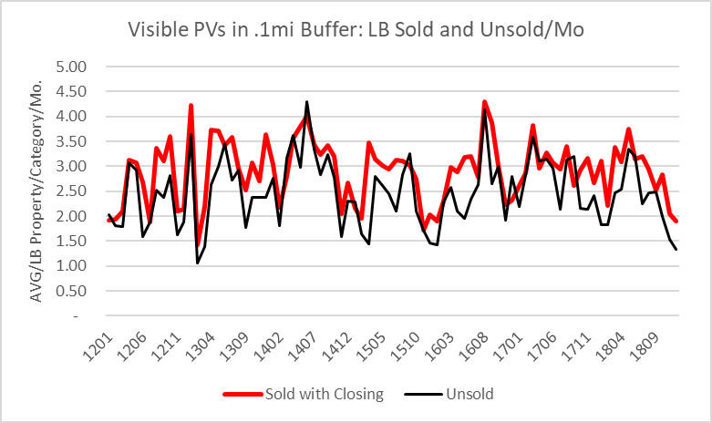
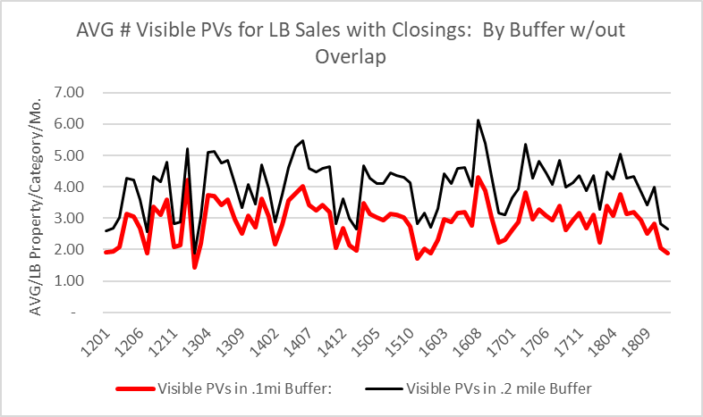
Property Violations

Slide 13
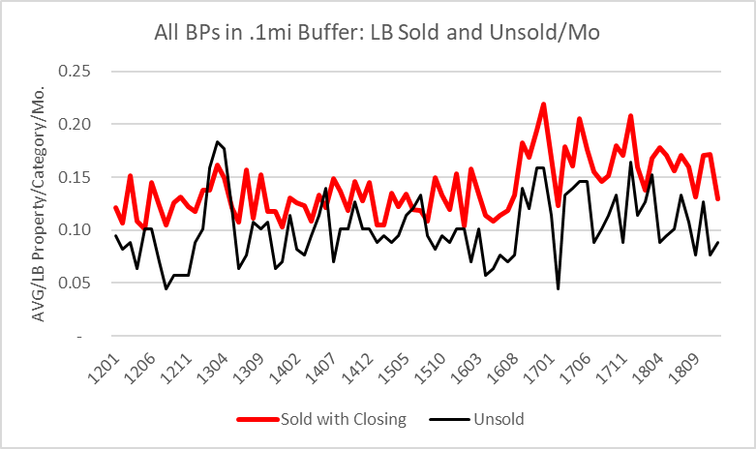
Building Permits

Slide 14
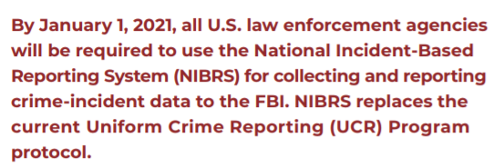
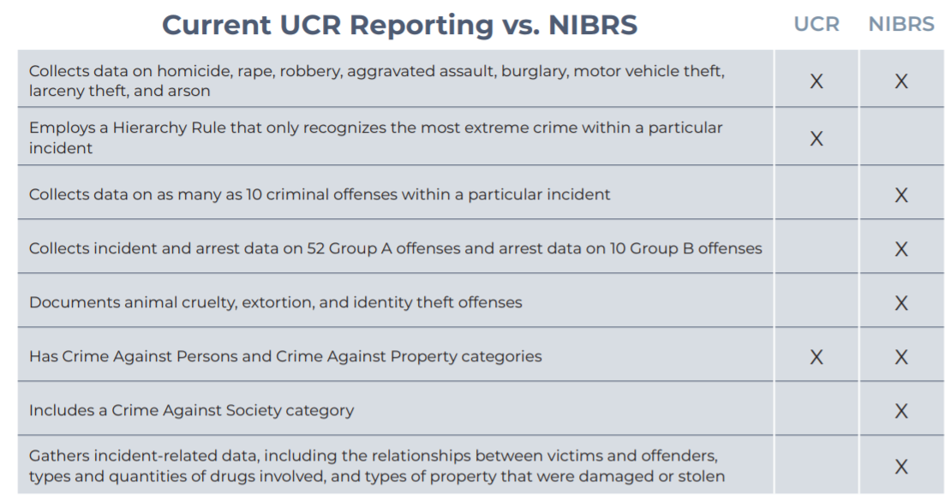
National Incident-based
Reporting System (NIBRS)
Uniform Crime Reporting (UCR)
shifting to:
National Incident-based Reporting System (IBRS)

Slide 15
Unique Report/IBRS Crime Categories
Crimes Against Persons, Property, and Society
15 Crime Group Categories
61 IBRS Codes

Slide 16
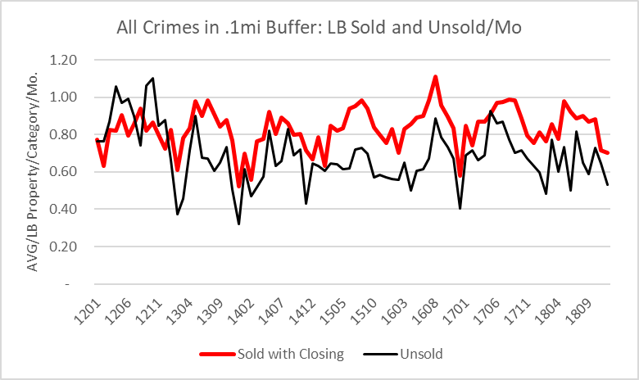
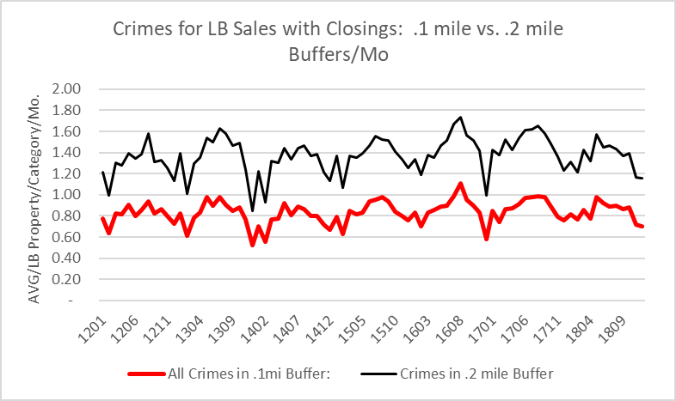
Total Crimes

Slide 17
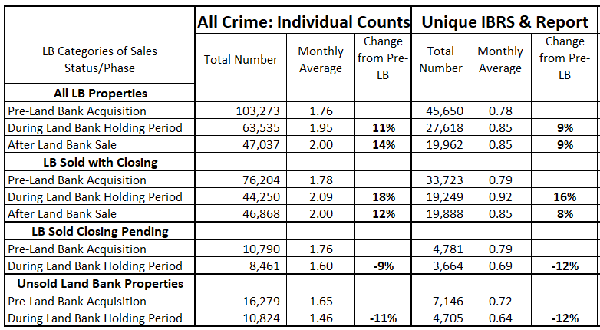
All vs. Unique Crimes in .1m Buffers

Slide 18
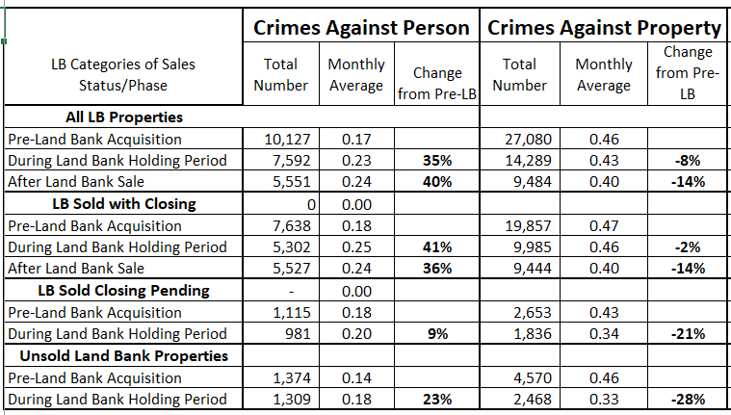
Crimes Against Persons vs. Property

Slide 19
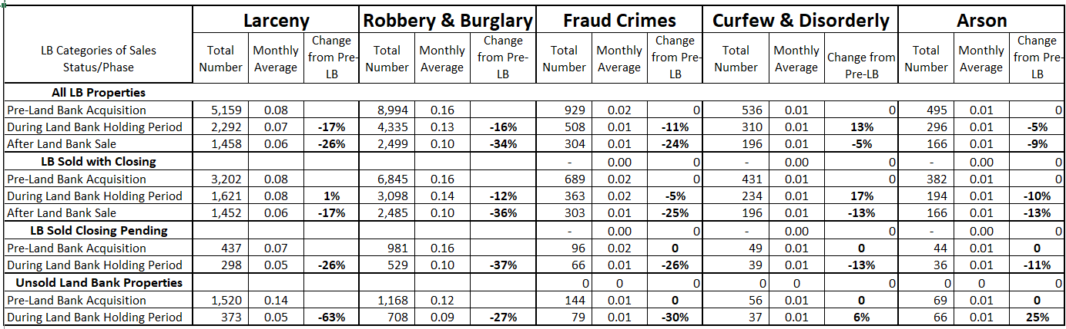
Types of Crimes that Declined

Slide 20
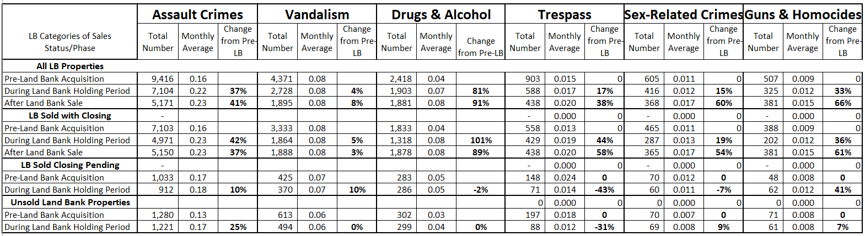
Types of Crime that Increased

Slide 21
Interactive Effects on/of Environs

Slide 22
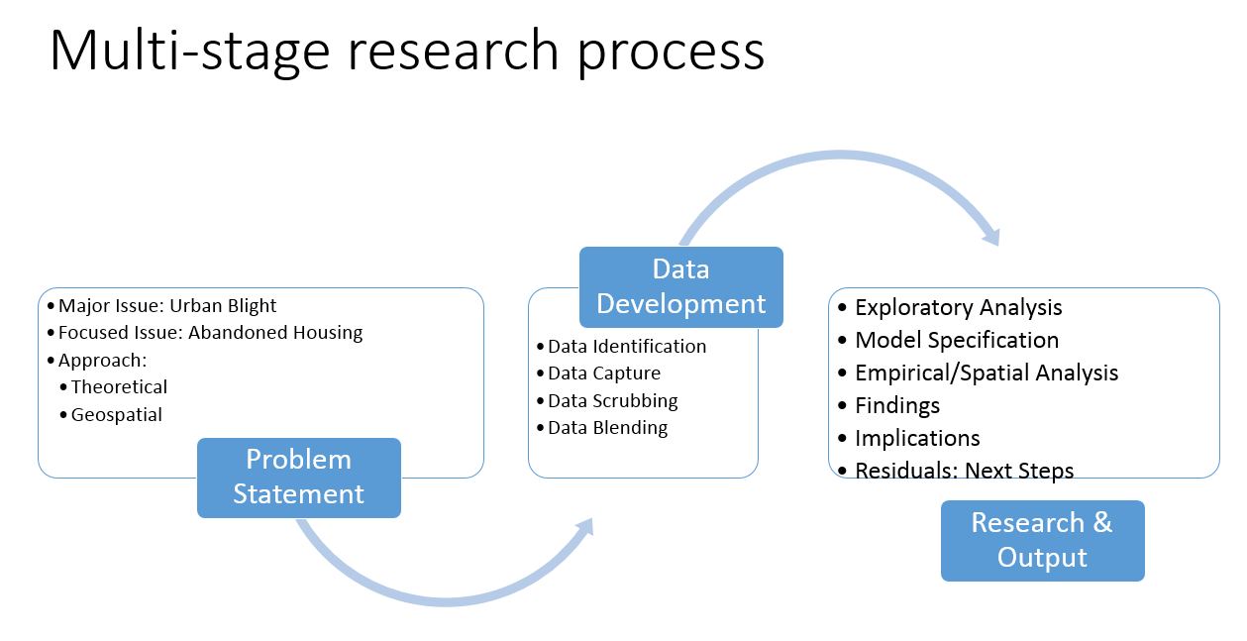
Preliminary Conclusions….
Abandonment/Urban Blight Problem
  Applied theory and spatial analytics can provide insights
  Interdisciplinarity: it’s all connected (environs, health, crime, indiv. behaviors, engagement)
  Outcomes based on behavioral processes in which place matters
  Dependent and predictor variables have cause and effect relationships
Future Research….
  Multi-level modeling
  Differences in Differences

Slide 23
Land Bank: Environs Multi-Level Model
Levels
One Abandonment/LB Property Attributes (condition, value, 311/PV history)
  Two Decision-makers Buyers Profiles, LB Policies ($1 sales, buyer vetting)}
    Three Environ Indicators (311s, PVs, Crime, delinquency, vacancy, BPs)
      Four Demographics (age, HH status, race/ethnicity, education, income)
        Five Neighborhood (tenure, organization, engagement, vision)
          Six Community Policies (co-production, demolitions, crime)
            Seven Society (values, policies, programs, economy)
Interactions
  1-2, 1-3, 1-5, 1-6
    2-1, 2-3, 2-4, 2-5
      3-5……
Key Components
  Specification of predictor variables from multiple levels (Fixed Effects) – Variables to include – Key interactions
  Specification of correlation among responses from same clusters (Random Effects

Slide 24
Differences in Differences Model Specification
Model considers the interaction of crime as a loss (L(.) generating activity (A_{(Ξ)it}), hence L(A_{(Ξ)it}).
  This occurs over time as a sequence
    Reflects activities of independent or adaptive variables/forces that impact properties (Χit) or people/decision agents (α(i,t)
    Ωwhere the (I,t) subscripts set up a a specific event or property:space measure in t.
  States
    Pre bank environment
    Regime/policy operation of the Land Bank and
    After-Bank state or market.
The crimes in and over time set up a Y-Vertical vector summing to all crimes occurring in a given time period of the specified regime or state (S(it))
  L(A_{(Ξ)it})|S(t) , such that the column sequence is ((L(A_{(Ξ)it})|S(t=1), L(A_{(Ξ)it})|S(2)…. L(A_{(Ξ)it})|S(T).
  Each column is then summed and reflects an idiosyncratic average and spread. It also allows the calculation of event based frequency distributions of crimes per time period.

Slide 25
Measurement and Methodology
Total crime per Bank regime expressed as:
  ((L(A_{(Ξ)it})|S(i=1), L(A_{(Ξ)it})|S(2)…. L(A_{(Ξ)it})|S(I).
These vector distribution allow the measure of the joint distributions of each crime period time (year/month) and the distribution of crimes across the regime.
This allows a probability matrix of crime per unit of time of the form:
  Ut((L(A_{(Ξ)it})|S(t=1), L(A_{(Ξ)it})|S(2)…. L(A_{(Ξ)it})|S(T) = C(Ui((L(A_{(Ξ)it})|S(i=1), L(A_{(Ξ)it})|S(2)…. L(A_{(Ξ)it})|S(I)
The C indicated is a copula
  Measures an association of activities without having assuming in advance independence, adaptive relations or equivalent time units.
  This in turn allows a difference in differences causality test.

