Slide 1

An Introduction to Alteryx:
Urban Research Applications
Presented to:
Mid-America Regional Council (MARC)
Tuesday, March 5th, 2019
by
Jim DeLisle

Slide 2
Presentation Preview
Overview
Land Bank Problem Statement
Data Development
Analytics Application
Data Workflows
Application

Slide 3
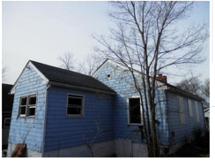
v2V-Lb Project Value Proposition
v2V-Lb
Land Banks and Abandoned Housing
  Abandoned Properties are a Significant Component of Urban Blight
  Land Banks Can Help Reduce Abandoned Housing Problem
Value-Add Proposition
  Help Land Bank Achieve Dual Mission
    Housing Access
    Economic Development
  Help buyers make more informed selection decisions
    Properties Selection
    Neighborhood Selection
  Stakeholder Tool
    Neighborhoods
    Policy-makers

Slide 4
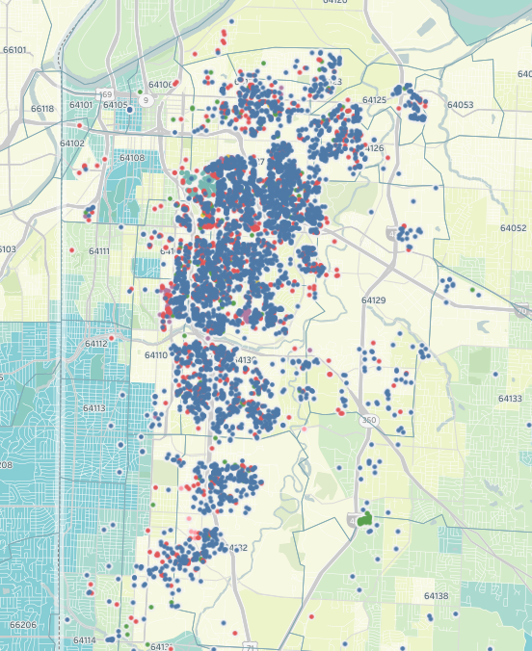
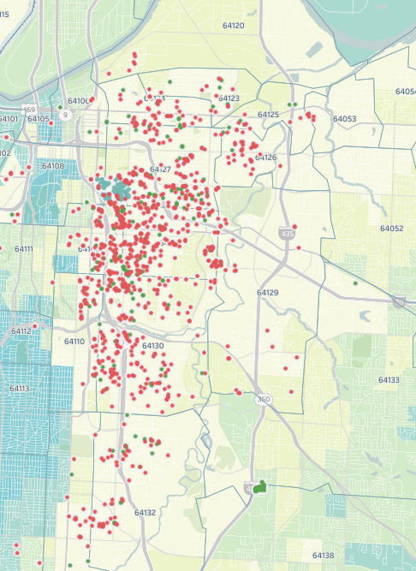
Total Land Bank
v2V-Lb
v2V-LB Context
Sold Land Bank
Land Bank Problem
  Inflow exceeds outflow
  Resource limitations
Property Profile
  Many properties in disrepair
  Neighborhoods often blighted
Buyer Constraints
  Resources
  Capital
  Information
  Risk tolerance
  Experience

Slide 5
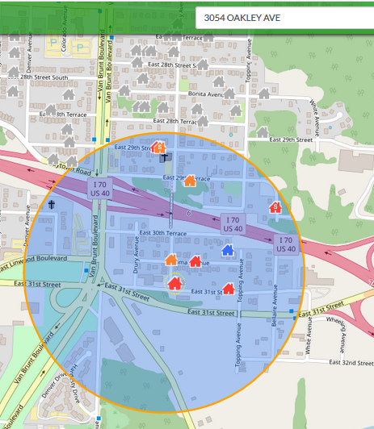
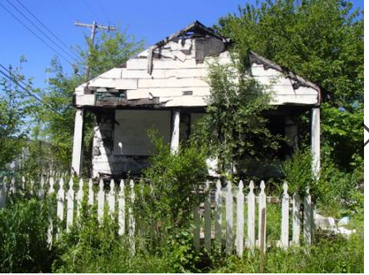
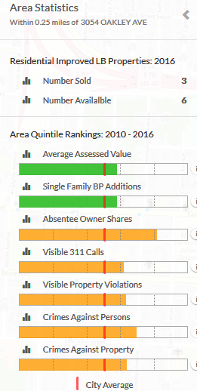
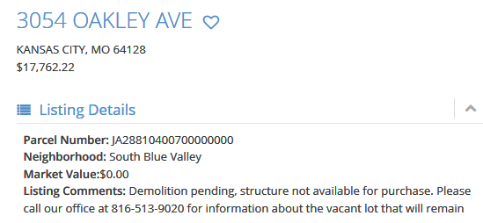
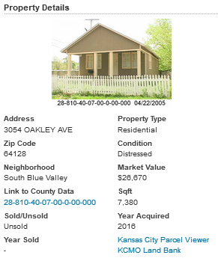
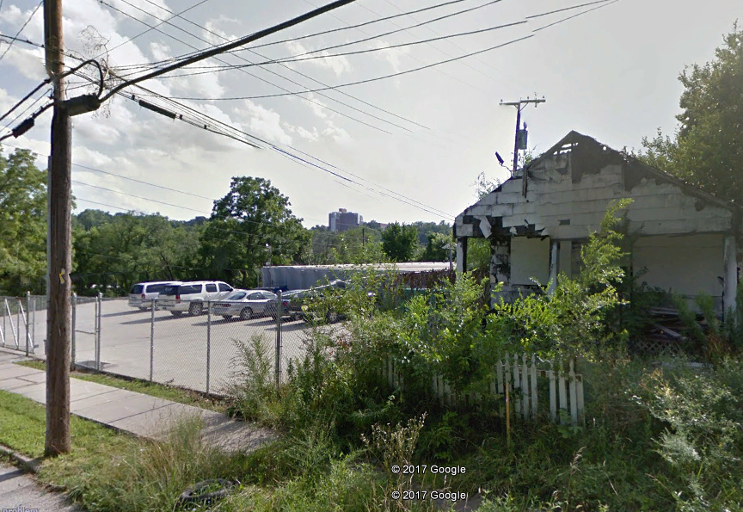
Issue: Sometimes, what you seek ain’t what you get..
v2V-Lb

Slide 6
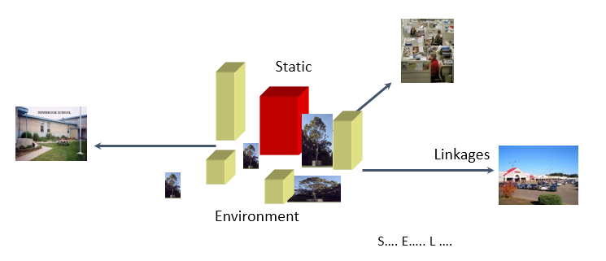
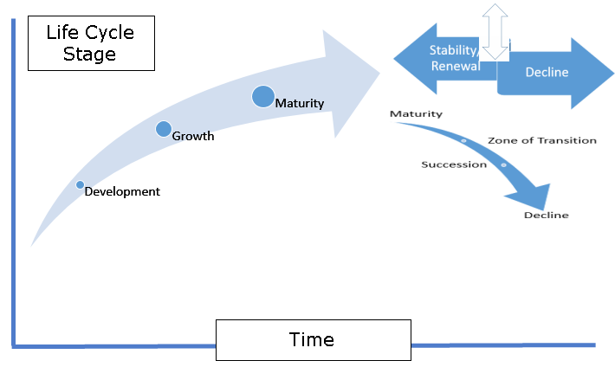
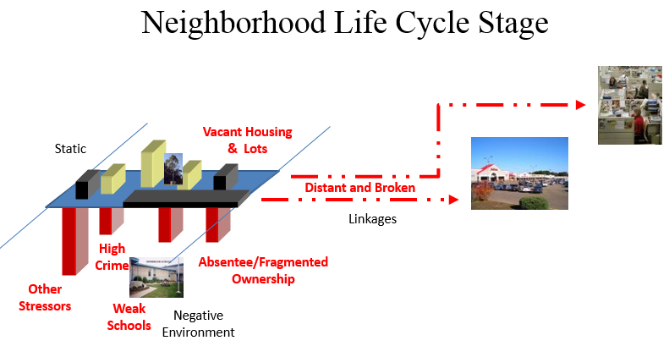
Applied Theory & Behavioral Approach
v2V-Lb
Vacant LB House
Neighborhood Life Cycles
Blighted Neighborhoods
Behavioral: What variables matter?

Slide 7
Data Development

Slide 8
Data Development and Analysis
Problem Statement
Data Development
Analysis & Output
Exploratory Analysis
Focused Issue: Abandoned Housing
Major Issue: Urban Blight
Case Study: Land Bank of Kansas City
Spatial Analysis
Improve Housing Access, Equity
Stabilize/Revitalize Neighborhoods
Predictive Analysis
Interpretation
Recommendations
Data Aggregation
Data Scrubbing
Data Capture
Data Identification

Slide 9
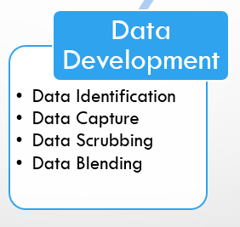
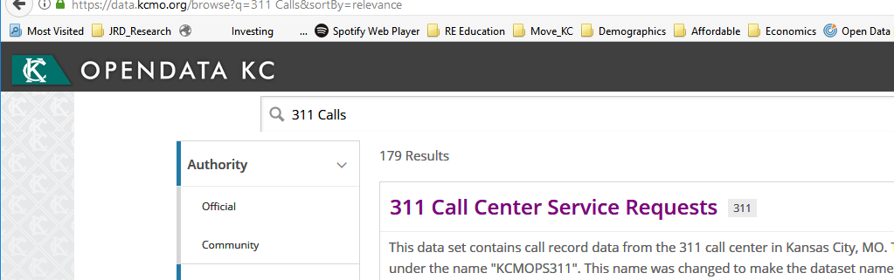
Data Development: ID and Capture
Data Identification: Neighborhood Variables
  Property Violations
  311 Calls: Resident Complaints
  Crime Rates
  Land Bank Properties: Sold/Unsold
  Building Permits
Data Capture
  KC MO Open Data Portal
  Jackson County Assessor Building Permits

Slide 10
Open Data Issues
Source-related
  Multiple Sources
  Collection Rationale
  Dissemination Standards
  Data Ownership
Data
  Data Standards
  Data Dictionary
  Data Integrity
  Data Continuity
  Data Processing
Data Development
  Errors (e.g., Address)
  Data Correction
    Internal
    Source
  Data Coding
Data-blending
  Common Fields
    Address
    APN/PID
  Updates
Data Output

Slide 11
Open Data Sourcing

Slide 12
Analytics & Application

Slide 13
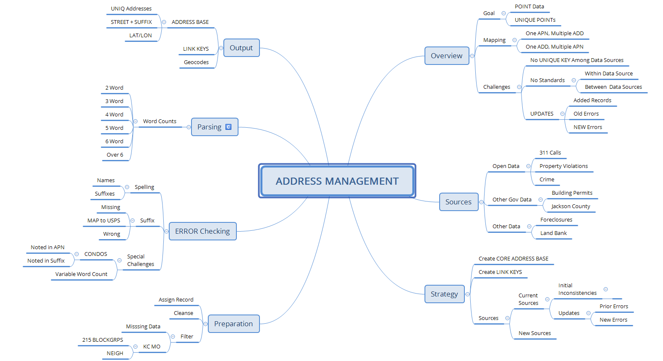
Address Management: Multiple Source

Slide 14
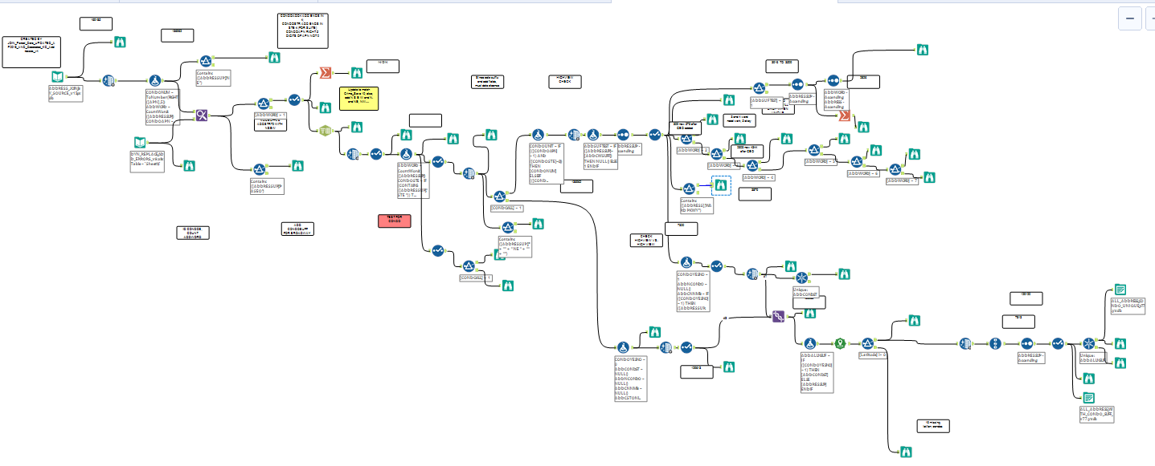
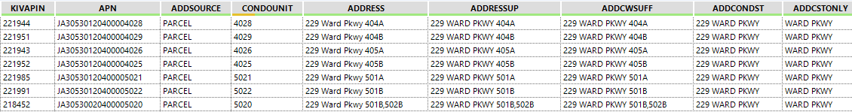
Address Standardization & Update
311, PVs at ADD Street

Slide 15
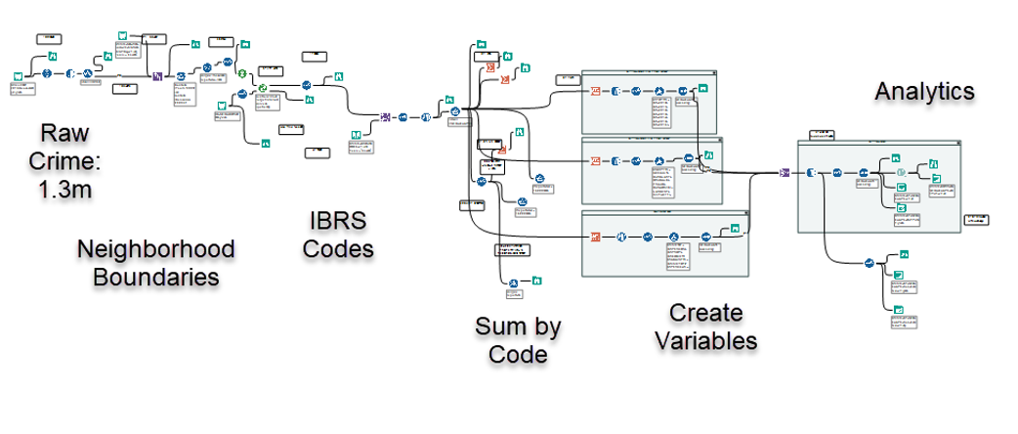
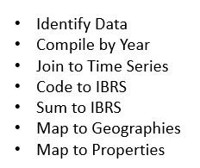
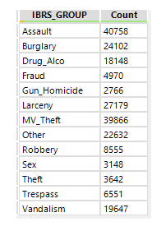
Crime
Step 3: Process
Step 1: Data Development
Step 4: Output
Step 2: Codes

Slide 16
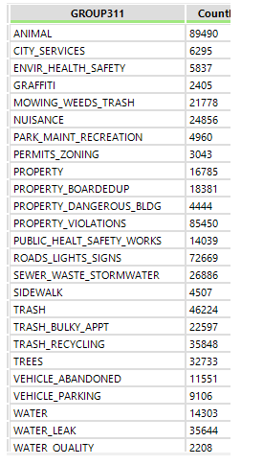
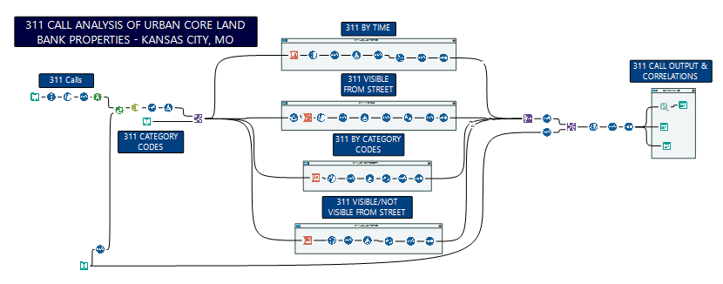
311 Calls: Mapping Table
356 Categories in Raw Data
Step 1: Codes
Step 3: Process
Step 4: Output
Step 2:
Visible vs
Not Vis

Slide 17
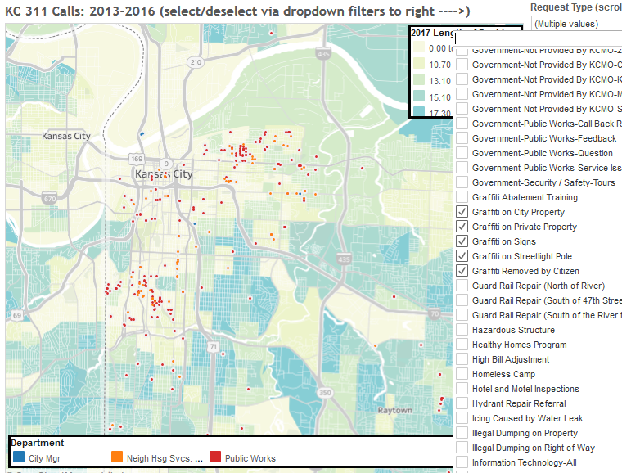
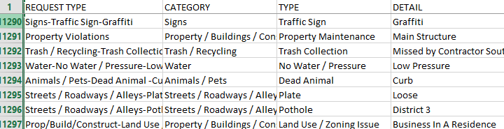
Issue: Disappearing Data-Graffiti Example
Change in Codes for Graffiti

Slide 18
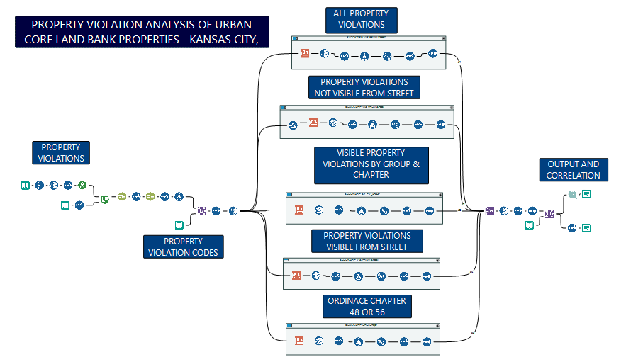
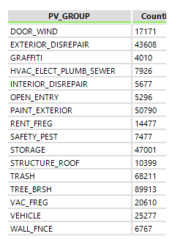
Property Violations
Step 3: Process
Step 1: Codes
Step 4: Output
Step 2:
Visible vs
Not Vis

Slide 19
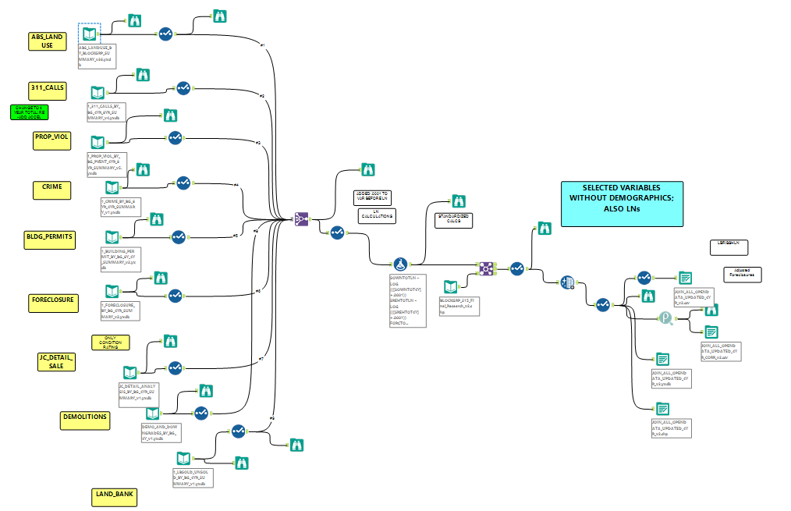
Join
All

Slide 20
Application 1: v2V-Lb Website..
v2V-Lb

Slide 21
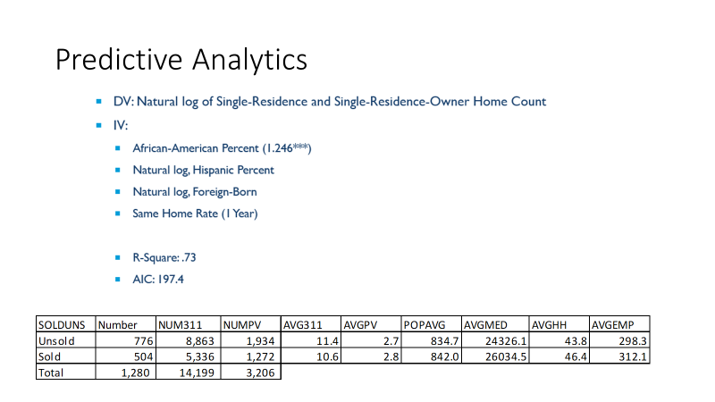
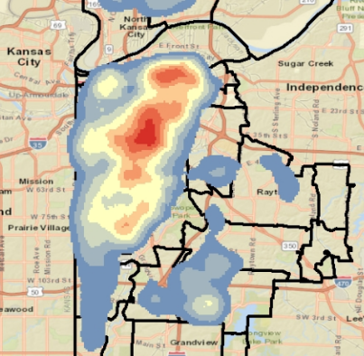
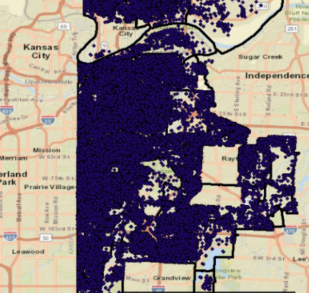
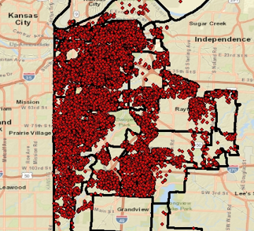
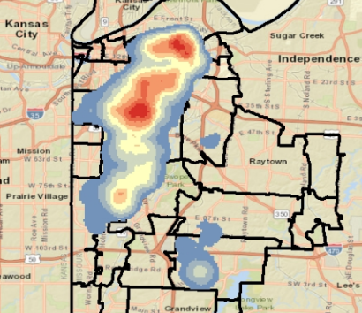
Application 2: Spatial & Predictive Analysis
311 Calls: Visible from Street
Property Violations: Visible from Street

Slide 22
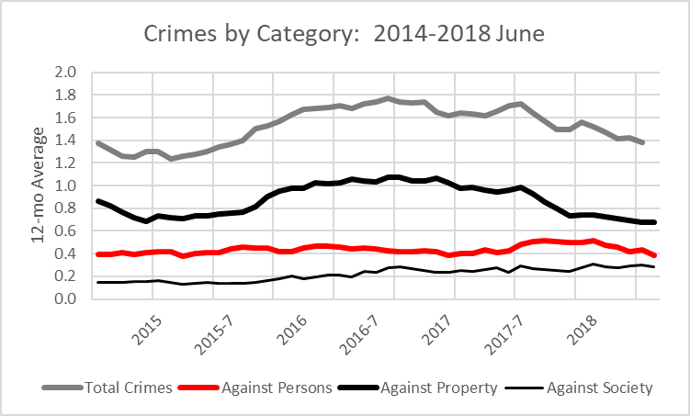
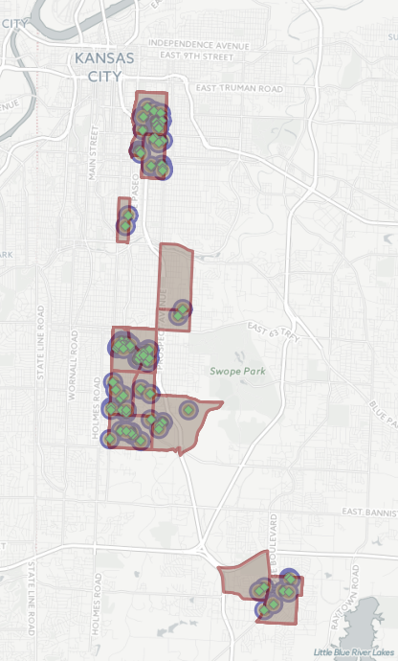
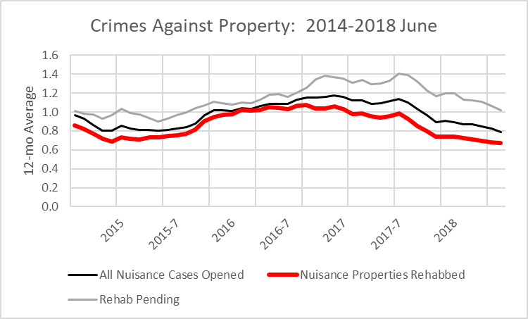
Application 3: Intervention Impact Analysis
Set Buffers
Compare Impacts
Explore Trends

Slide 23
Conclusions….
Abandoned Housing
  Market can become more efficient with added knowledge and insights
  Geospatial tools can help policy makers, program directors achieve missions
  Research, education, and technology can be harnessed to help individual buyers
Open Data
  Not a panacea
  Know thy data/own thy data
  Data is not information; needs processing
Conclusions (Preliminary)
  Analytics can be deployed to help support decisions
  Information must be brought to level of the target user

