Slide 1
Lecture 4 (a): Reflecting on the Future for Real Estate:
Leaner, Meaner, Cleaner and Greener
by
James R. DeLisle, Ph.D.
jdelisle@u.washington.edu
January 14, 2010
Notes:
This is a presentation made by Jim DeLisle, the Runstad Professor of Real Estate and Director of Graduate Real Estate Studies at the University of Washington.

Slide 2
Presentation Overview
  I: Macroeconomic Impact on Real Estate
  II: Capital Flows & Real Estate
  III: Real Estate Market Fundamentals
  IV: Implications for Seattle Real Estate
Notes:
The twenty0-minute presentation included a discussion of the capital markets and real estate fundamentals. Based on this background, the discussion turned to the challenges, issues and opportunities embedded in the current crisis and the implications for Seattle’s Real Estate Market

Slide 3
Part 1 Prelude: Three Major Attributes of Real Estate
Three major attributes of real estate . . .
  L,
  L,
  L.
Three major attributes of real estate . . .
  L,
  L,
  L.
L
  . . . . . . . ulnerable,
  . . . . . . . ulnerable,
  . . . . . . . ulnerable.
L
L
The 2009 regime of real estate . . .
  D
  D
  D
  . . . . . . . istressed,
  . . . . . . . istressed,
  . . . . . . . istressed.
The 2010 + regime of real estate . . .
L, L, L
Butt, what the “L”?
Liability, Litigation, Liquidity (NOT!)
Notes:
This slide is designed to disarm the audience a bit and get them thinking creatively and out of the box. The play on the Location, Location, Location theme points to the Vulnerability of real estate due to the potential impact of a range of externalities. It also introduces the “D” word for distress. We also talked about the dreaded “R” word which to some might be “Recession” but to developers is “Recourse” which is coming in future loans resets which are hanging over the industry.
In something of a return to fundamentals, the L, L, L is back in vogue for 2010. Unfortunately, instead of Location, Location, Location, they will stand for Liability (recourse for borrowers), Litigation for a lot of players, and Liquidity (NOT) reflecting the inability to access debt capital and the challenges sellers will face when the glut of distressed assets clouds the market.

Slide 4
Part I: Economic Environment for Real Estate
2009 Outlook
Economy in recession; painful and long
Businesses struggling, stocks volatile
Consumers & CEOs bearish
2010 Outlook
Recession over; slow recovery; some downside risk
Big businesses okay, Small struggling, stock market up
Consumers guarded; CEOs hopeful
Notes:
The economic snapshot is bleak, with the economy moving into a recession, businesses struggling, the stock market trying to bottom out and consumers out of the picture. Unfortunately, there are no quick solutions on the horizon with more downside risk than upside potential.

Slide 5

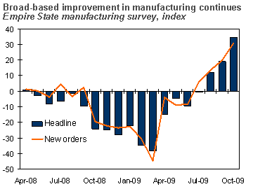


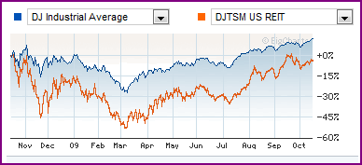
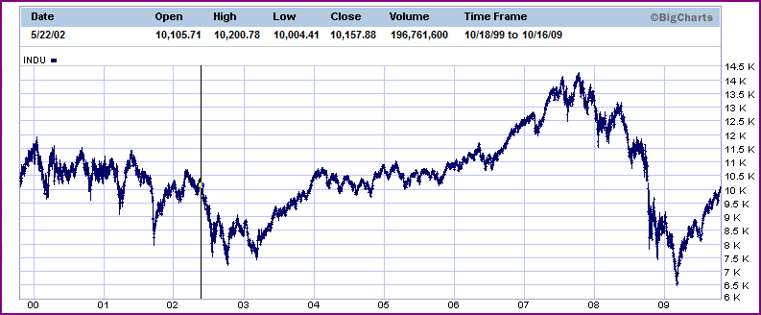
Breaking News on Real Estate & the Economy
Notes:
There has been some good news, with GDP expected to turn positive in the 4th quarter although any recovery is going to be tempered. The stock market is certainly poised for a recovery, with investors anxious to regain some lost ground. The outlook for the construction industry is based in part on recovery in the housing market which is likely to disappoint many unless the tax credit program is extended and employers start adding jobs. On the other hand, stimulus backed spending on infrastructure is likely to provide some ballast for the sector. The excess capacity built into the current commercial market will make that a lagging sector when the economy does recover.

Slide 6
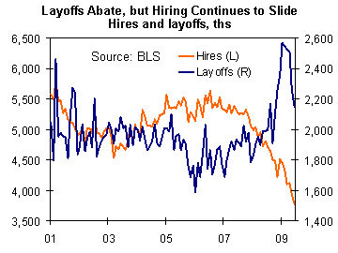
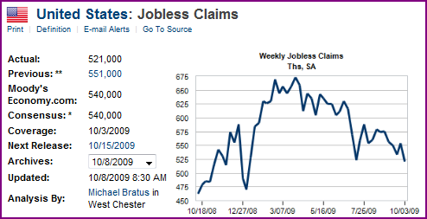
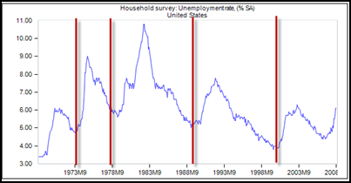
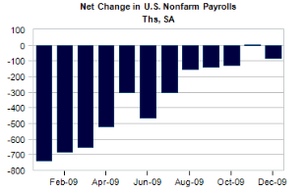
The Good News: Employment Losses Slowing
Net Employment losses
Jobless Claims Slowing?
10%
Unemployment
Source: economy.com
Notes:
One of the key challenges to the US economy is the softening in employment and rising unemployment levels. We asked the audience if they agreed or disagreed with the statement that employment was set to improve in early 2009. Some 93% of respondents indicated no, suggesting they anticipate weakness on the job front to continue. In order to help with the unemployment figures in context, it is useful to look at unemployment levels in the prior recessions. As noted in the graph in the upper left of the slide, unemployment levels in the 70s early 80s and early 90s were much higher than the current levels.
Given the weakness of the US economy compared to those times and the prospects of further erosion, unemployment rates are likely to remain sticky around the 10% hurdle. Whether they will break into double digit levels will depend a lot on how the economy settles down and how recent and future government interventions work. Over the near term, conditions are likely to erode even further with weakness across most sectors including state and local governments whose budgets are getting hit hard. Thus, the lack of employment growth is expected to continue to put a damper on the economy and consumer confidence.

Slide 7
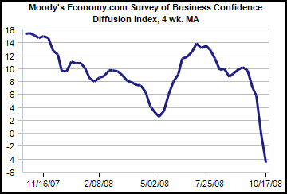
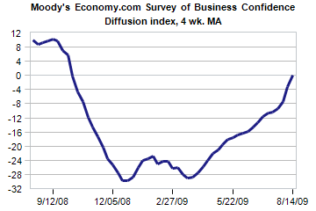

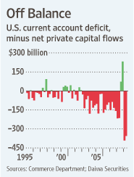
Business Confidence
U.S. Business Confidence
Some improvement….
9/12/08
But, deficit….
9/12/09
Source: economy.com
Notes:
Business confidence remains weak in with respect to hiring and expansion planning. Unfortunately, businesses aren’t receiving the same attention as households in terms of assistance with the exception of financial institutions and the auto industry. With credit tight, pessimism will likely pervade the near-term outlooks even more than in the recent past.
The situation is clearly global, with confidence levels down in most developed nations. Emerging markets are struggling even more than “normal” in the tight credit environment although spreads have eased a bit. The deficit remains a concern, especially with exports languishing in spite of the cheap dollar.

Slide 8
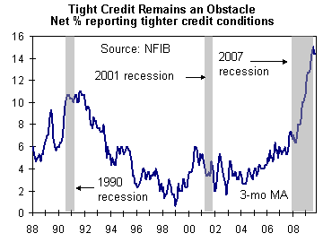
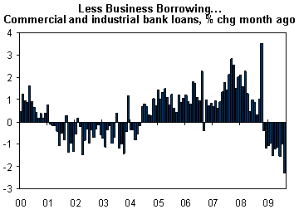
Focus on Small Business
Credit Remains Tight for Business
Small business report tighter credit
Reactions
  Cutting payrolls
  Reducing inventory
  Reducing capital spending
Outlook
  No near-term improvement
Source: economy.com
Notes:
Although there have been some positive signs on the business front, the situation in which many small businesses find themselves is still dire. After experiencing tight credit noted in the upper right graph, businesses began to cut back on payrolls, inventory and spending. As such, business borrowing has actually declined. This situation can be explained in part by the tight credit, as well as tempered outlooks. Unfortunately, with small businesses a critical factor in job growth, these cutbacks do not bode well for the recovery until they turn the corner.
The tight credit markets are likely to continue with record levels of commercial debt and mortgages coming due over the next 2-3 years. Until the banks and other sources of credit loosen up, smaller businesses will continue to be on the defensive.

Slide 9
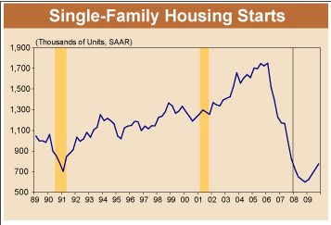
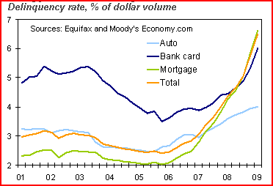
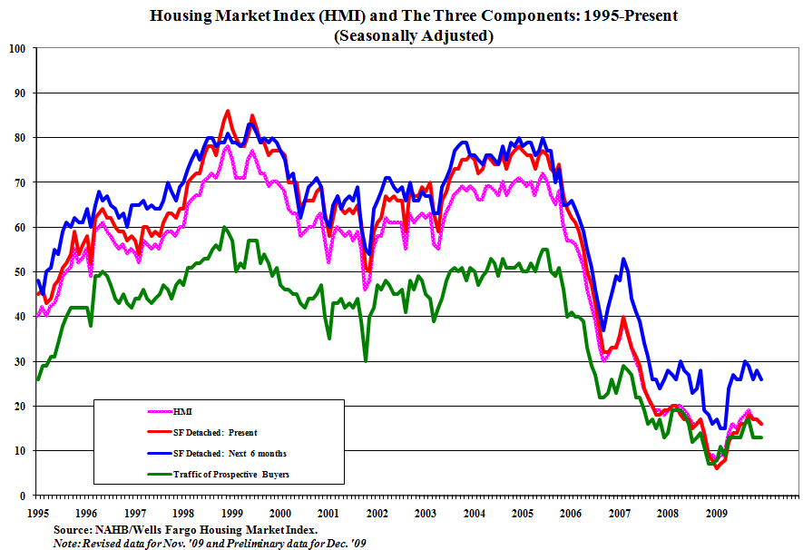
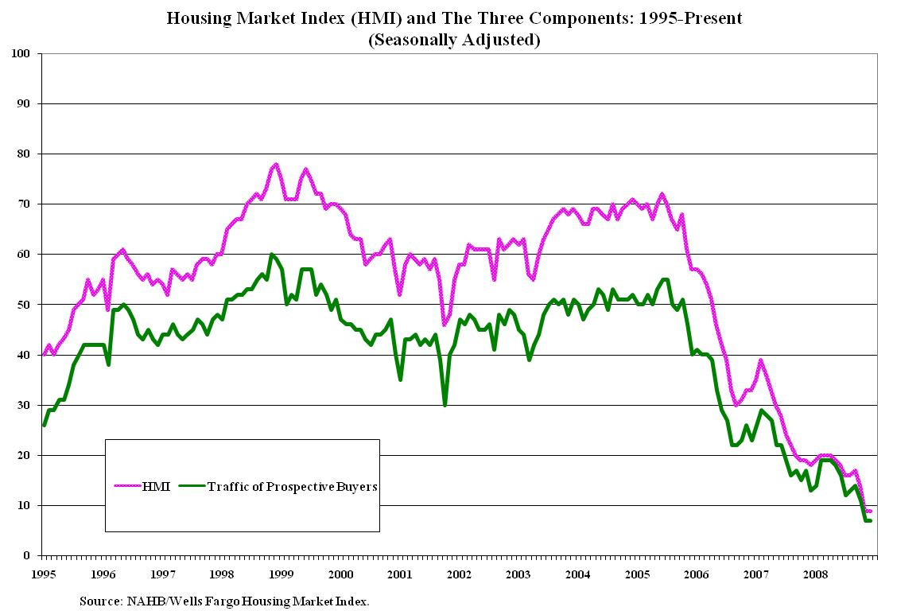
Housing Market Indicators
Housing Starts
Delinquency & Default
Housing Index
Homebuilder Confidence
Notes:
The housing market is in a somewhat tenuous state, with some buyers being drawn back into the market due in part to the first-time homebuyer credits. Although there is a lot of positive rhetoric about it being time to get off the fence, there are few signs that the market has fully bottomed out. Housing permits and starts have picked up a bit after plummeting to the lowest level in over 20 years. While inventories have been declining, sales levels and traffic remain low as potential buyers wait for the economy to improve.
In a number of overheated markets, raw land values have already plummeted by 60-70% from their 2006 peak levels. Delinquency rates continue to rise at an accelerating pace, spreading across the country as the consequences of easy credit hit home. In the absence of meaningful intervention, this trend is likely to continue, especially with estimates that some 30% of households who bought in the last five years are underwater, the principal balances greater than market values. At this point, some reminisce about the “It’ll be fine in 2009,” and are now resigned to “But then again, it could be 2010.” Unfortunately, those timetables may be realistic, depending on how long it takes the market to bottom out and capital to return to the sector.

Slide 10
Housing Stimulus Efforts
First-time Homebuyer
  Tax credit of up to $8,000 for first-time home buyers
  Before April 2010, close before June 30.
  2009: income max $75,000 for individualsand $150,000 couples
  2010: income limits $125,000 individuals, $225,000 for couples
  Max price: $800,000
Existing Homebuyers
  Tax credit of $6,500 for repeat buyers
  If owned five consecutive years out of the prior eight years
Repay if not used as principal residence within three years

Slide 11
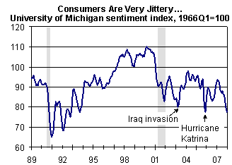
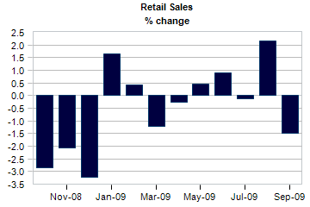
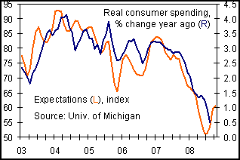
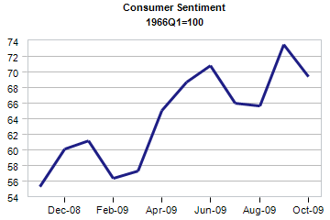

Consumer Confidence, Spending & Credit
Consumers Contracting
Consumers are over 70% of GDP….
Source: economy.com
As of October 2009, recent uptick in retail sales on Year over Year; partly weak 2008…
Butt…
Notes:
Since they are consumers themselves, the respondents provided some interesting insights into the prospects for consumer spending. Some 80% strongly agree or agree that consumers will continue to contract expenditures. This anticipated decline is noted by the high correlation between confidence levels and consumer spending; both of which are expected to continue to struggle. More recently, consumers have cut back on installment credit which might be taken as a good sign, although it is more likely due to the pressure of mortgage debt and the desire to hunker down in order to hang onto their houses and make it through the rough times they see ahead. Given how households are being squeezed in terms of budgets, it is unlikely that savings rates will move back into positive territory, especially as consumers have little confidence in the stock market.
It is well known that the US is a consumer led economy. Indeed, with the slowdown on the business side of the equation, retail drives over 70% of GDP. The recent numbers show some improvement, with October 2009 sales up vs. year ago figures; unfortunately, they were so bad last year this improvement is not very meaningful. Also, once the car clunker program expired, retail sales contracted as might be expected in light of the tough economy and continued job losses.

Slide 12
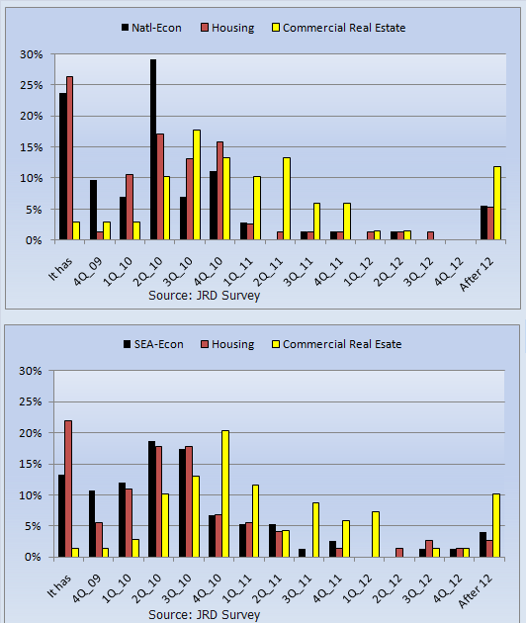
When National & Seattle Markets Bottom Out?
National
Seattle
Sources: JRDeLisle, IREM Survey Respondents
Notes:
To get a general sense of where we are in the cycle, respondents were asked to indicate the timing of a bottoming out for the economy, housing market and commercial real estate market. These questions addressed the overall national markets, as well as the local Seattle/Puget sound market. As noted, many thought the economy had already turned or would in the 4th quarter. The opinions on the housing market were much more divided, with responses ranging from it already has to the fourth quarter of 2010. As to the commercial real estate market, the bottom is at least a year or more off; a position I also hold.

Slide 13

Critical Elements to Sustainable Recovery
The Future Remains Uncertain
Sources: JRDeLisle, IREM Survey Respondents
Notes:
This slide presents the responses to a series of questions soliciting the relative importance of various factors to a sustainable economic recovery. In addition to the insight shared by individual questions, the real message is in the fact that most are “Very” or “Important.” This suggests the stars have to stay in line and there are few degrees of freedom should the economy stumble. As might be expected, job growth rather than slowing losses is the most critical factor.
Interestingly, the lowest scores were for continuation of federal stimulus programs which may well be more a function of the relative lack of success they have achieved and frustration among taxpayers who realize someone will ultimately have to pay the piper.

Slide 14
Part II: Real Estate Capital Markets
2009 Capital Market
Wavering, delayed investor demand
Rising Cap rates, declining values
Challenge in de-levering asset class
2010 Capital Market
Tentative, waiting to pounce, new players & rules
Rising Cap rates, declining values de-capitalizing
Challenges re-levering; credit crunch for asset class
Notes:
Looking at both the economic and capital markets, there are a number of danger signals for commercial real estate. For the first time in years, capital flows may actually decline as assets are repriced and owners forced to come up with more equity at higher yields that are commensurate with the attendant risk. The prospects of a deep and prolonged recession create significant downside risk that has yet been priced into the market.

Slide 15
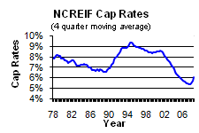
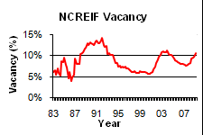
Spatial & Capital De-connect and Re-connect
Capital Market
BV
(Bubble Value)
Capital
Market
Bubble
Debt -20%+/-
Bubble
Cap Rate Rise
Interest Rates/Debt Rise
Warranted
Construction: Expanding Demand
Spatial Market
Cap R -20%+/-
Bubble
Market -10-20%+/-
Softening
Rising Rents
Vacancy Up
Rents Down
-40-60%
Values
Market
Inefficiency
Notes:
Given the multidimensional nature of real estate and its fixed location, real estate is subject to a number of external forces which change over time. These cyclical forces include the broader macroeconomic environment, capital markets and spatial markets. Each of these forces has a temporal nature which leads to market cycles characterized by periods of excesses or shortages of space, both relatively and in absolute terms. Since some of these forces are correlated, they can put pressure on the nature ebb and flow of markets and add to the amplitude and frequency of market cycles or waves. One of the more recent “externalities” is the surge in capital flows to the asset class which led to imbalances on the supply/demand side of the equation, as well as on the pricing. This latter occurred as a result of shortages of investable product which, due to the lags in construction and supply, created upward pressure on prices for existing assets and declining yields.
Going forward, we are likely to be facing a prolonged period of heightened cycles, both in terms of frequency and severity. Drawing on my experience in the 90s and what I have seen in terms of the spatial/capital divide, I believe institutional property in mark-to-market accounts may lose 40-60% of value. If so, we’re slightly more than half way there; a difficult outlook at best.

Slide 16
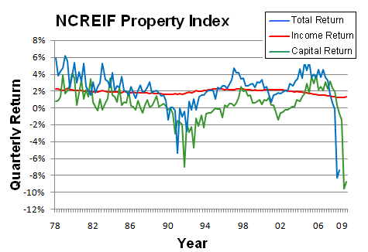
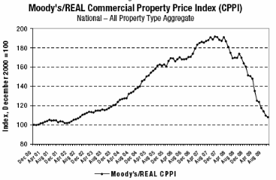
How We’re Doing: Commercial Real Estate
Private Equity
The Good News….
It’s not as bad as it was
Notes:
In addition to opportunity funds, core institutional real estate has take a major hit. According to NCREIF data, values have fallen some 35% or so. Unfortunately, more losses are ahead as cap rates rise and NOI deteriorates even more. The good news –glass is half full- view suggests the rate of losses is slowing down. While true, the implicit cap rate is still too low suggesting more adjustments are coming. Furthermore, the 3=10 year numbers are so weak they call into question the assumption of continued allocations to the asset class, especially since it will likely lag other asset classes on the recovery side.

Slide 17
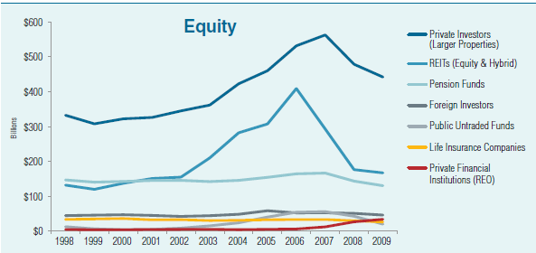
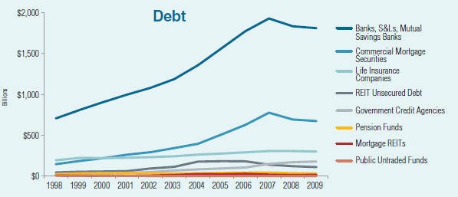
Trends in Capital Flows

Slide 18
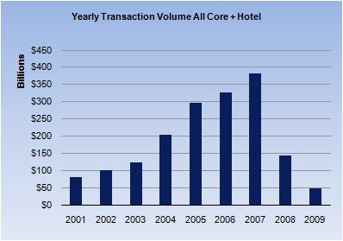
Institutional Equity Capital Flows
Investment Preferences
  Search for Value/Clean
  Eschew risk
  Fewer products/structures
Timing
  Patient; waiting for bottom
  Indecisive; slower to act
Decreased capital flows
  Rising Return/Yield hurdle
  Denominator effect
Opportunities
  Off-market, quiet deals
  Bank REO, asset Takeovers
  Structured finance, sales
  Convertible positions
  Public/Private Ventures
Source: 2009 Emerging Trends
Notes:
With respect to institutional capital flows, a number of trends create downside risk for the commercial sector. First, capital flows will decline, both from domestic and international sources distracted by credit crises sweeping the globe. Second, investors will search for value and eschew risk, looking a simpler structures and products. Third, investors will be patient and wait for signs the market is bottoming out; they will be indecisive and slower to act, especially those lacking a firm understanding of real estate fundamentals. While this capital environment will create problems for many, it does offer some opportunities. In general, cash will be king, especially if it is mobilized and can act in a preemptive manner as sellers and holders panic or are forced to action. A good source of product for such investors will be “channel sourcing” or looking at REO, TICs and highly leveraged buyers with limited ability to refinance who will begin to recognize their plight. There will also be opportunities in asset takeovers as investors lose confidence in current advisors who got them into high priced assets, as well as in portfolio acquisitions where large blocks of product --both direct and securitized-- will be on the market and looking for a quick exit. Finally, players with real estate expertise may be able to swap talent for assets, taking over troubled properties or getting stakes through sweat equity and promoted positions.

Slide 19
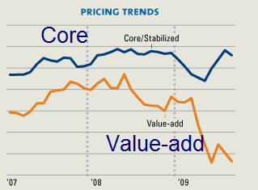
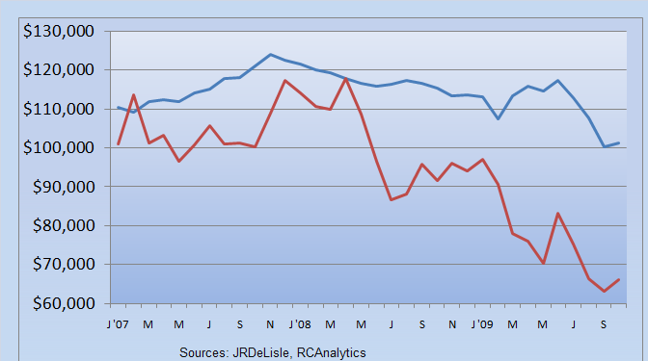
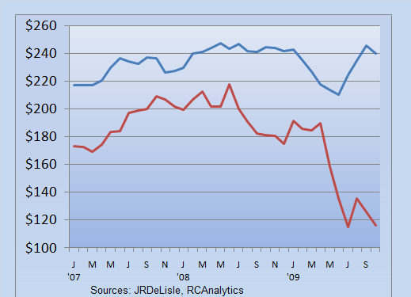
Emergence of Two-Tiered Pricing System
Apartments/Unit
Core
Value-add
Suburban Office/SF
Core
Value-add
Notes:
Although transaction levels have been relatively low, the transactions that have occurred reveal the emergence of a two-tiered pricing system in which core assets (e.g., proven assets, fully leased, solid cash flows) are trading at a much higher value than distressed assets. This situation is likely to hold, although the glut of distressed assets that will hit the market is likely to create some convergence as buyers find it difficult to identify core assets from the impending flood of listings.

Slide 20
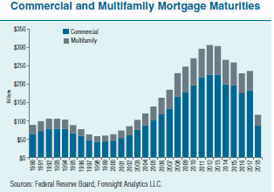
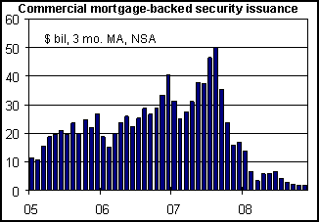
Commercial Mortgage Capital
Tightened Credit
  DCRs: pressure on income
  LVs: Reduced; equity risk exposures
  Risk Rebirth: recourse debt
Outlook
  Impending Crisis
  Flight to quality
  Tighter; increased equity and recourse
  Meaner; more aggressive foreclosures
Opportunities
  Selective, lower risk, seasoned assets
  Creative financing: convertible debt
Notes:
As noted in this part of the cycle much attention has been focused on a problems in the subprime credit market and credit swaps. Unfortunately, while the press, politicians and regulators have focused attention on those sectors, the commercial real estate market has escaped outside scrutiny. However, those on the street realize the lure of easy credit and lax underwriting was as prevalent as in the residential sector. Indeed, the commercial sector is facing a number of problems stemming from the turning tide in credit markets affecting both the ability of borrowers to pay (i.e., rising vacancy rates, declining rents) , and in the willingness of borrowers to pay in the face of erosion of the equity value and tighter credit. The dramatic erosion in access to the capital for commercial investments is evidenced by the fact that it’s really doing a number of transactions in 2008 depending on the ability to assume existing financing. Going forward, assumptions will be much more difficult to affect with tightening credit standards, higher equity requirements, and a return to non-recourse debt carrying the day.another first for sure that over the near to intermediate term which may well extended to 2010 is for limited supply, higher spreads, and tighter underwriting standards.

Slide 21
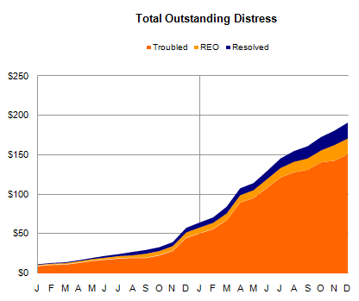
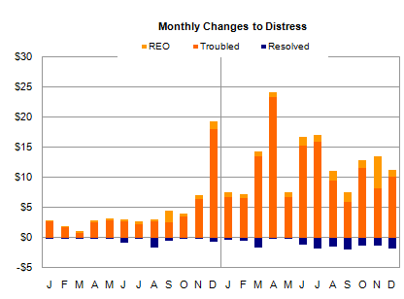
Capital Market Clouds: Distressed Assets
Distressed and Resolved Assets
Downstream risk of a flood….

Slide 22
Players in Distressed Asset Market
REITs
  Have reversed downward spiral
  Significant new capital raised through Sept 2009
  Low Dividends suggest accretive opportunities
Global Investors
  Western European
  Middle East
  Asia/Australia
Domestic Funds
  Significant growth inUS
  New Opportunity Funds
  New Value-Plus Funds
Notes:
A number of sources have suggested that well over $200 billion of equity capital has been assembled to acquire commercial real estate at distressed prices. While much of this capital remains on the sidelines, it is interesting to note the general sources of capital that are lined up. After a difficult 2008, REITs have been doing fairly well in year-to-date performance, with a number of larger REITs raising some $12 billion of capital in the first half of the year. The ability to raise capital for the otherwise distressed asset class is reminiscent of the mid-90s when REIT market cap surged from sub-$10billion to some $200 billion.
Offshore investors will also likely be active players in the US real estate market when it begins to move, although the US real estate recovery is expected to lag other developed nations. Finally, a number of existing and new domestic funds will be established over the near term as sponsors try to take advantage of the market malaise and the strong talent who could implement successful investment programs on the street.

Slide 23
Part III: Spatial Market Fundamentals
2009 Spatial Market
Fundamentals continue to weaken mirroring economy
Vacancy rates rising, rents softening
Stagnating demand, tempered recovery
2010 Spatial Market
Still weakening, negative absorption; more downside risk
Vacancy rates pushing records, rents declining
Negative absorption, lagged recovery
Notes:
In looking at the snapshot of the spatial market --supply and demand for real estate-- the bottom line echoes that of the broader economy and capital markets. That is, there is some additional downside risk associated with a combination of a slowing economy, tighter credit, a renewed interest in risk, and weakening fundamentals. That situation should prevail over the near-intermediate term, with commercial real estate lagging the broader economic recovery which is well into 2009 at best. These will be interesting and challenging times with some opportunities for those willing and able to take advantage of the market malaise and lack of capital.

Slide 24
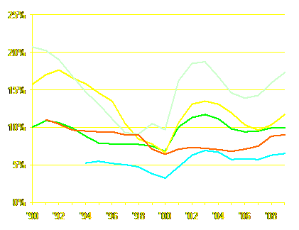
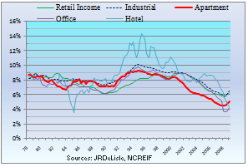
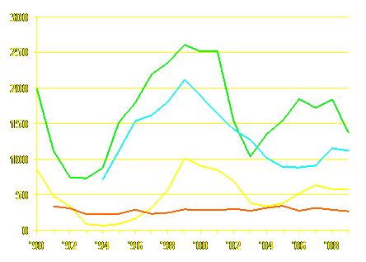
Commercial Market Trends
Vacancy Rates
Cap Rates
Suburban Office
Downtown Office
Industrial
Retail
Apartments
Apartments
Development (msf)
Industrial
Office
Retail
Source: Torto Wheaton Research, REIS, 2009 Emerging Trends

Slide 25
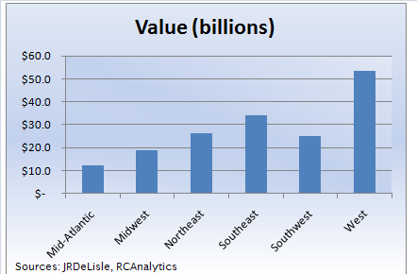
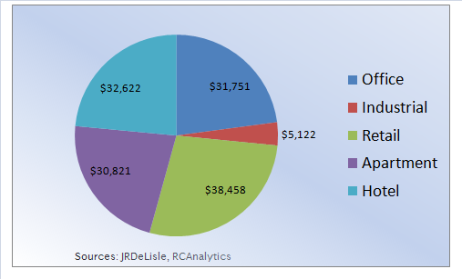
Distressed Assets: Region and Property Type
Regional Share
Property Type Share
National: $170 b

Slide 26
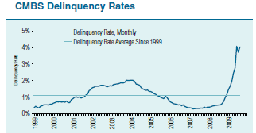
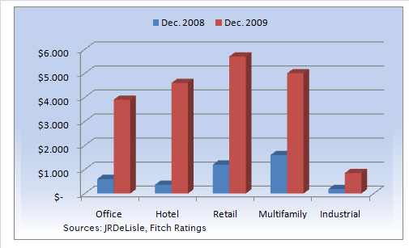
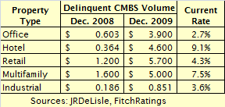
CMBS Delinquency Rates by Property Type
Trends
Rates could
hit 12%

Slide 27
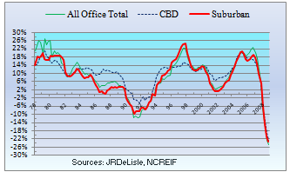
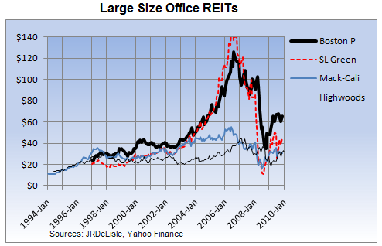
Office Real Estate
Overview
  Negative absorption
  Subleasing increase
  Vacancy rates rising
  Rents declining
  Market freezing
Opportunities
  Abandoned Projects
  Entitled Projects
  Capital Needs Projects
  Asset Takeovers
  Distressed Owners/REO
Notes:
During 2008, the office market has shown some signs of weakening, with increases in vacancy rates and softening rents occurring in many markets. For the most part, this moderate contraction has been related to the slowing of the overall economy and rising unemployment rates. However, the crisis that has hit the credit markets and financial sector the hardest have factored into the equation, especially in markets which depended heavily on financial services and related businesses. As the scope of the credit and financial crisis became clearer, the ripple effects of the contractions spilled over to a number of markets. Although rental rates had held up through the early phases of this correction, the market is beginning to experience some downward pressure. This is especially pronounced in markets facing major job cuts resulting in tenant givebacks and a rise in subleasing activity. Given recent economic activity, the office sector is expected to continue to struggle, with some downside risk. Particular areas of concern include spec projects, commoditized assets, assets in need of defensive capital, and assets in weaker locations and markets. There will be a number of opportunities including distressed projects, asset takeovers and challenged sources (e.g., REO, corporate downsizing and leveraged owners facing refinancing).

Slide 28
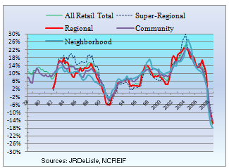
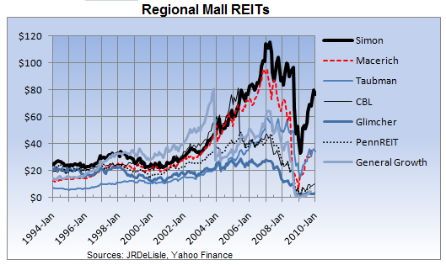
Retail Real Estate
Overview
  Vacancy rising
  Retail sales soft
  Inventories leaner
  Credit tight
  Retailer contraction moderating
Opportunities
  Projects with Lost Anchors
  Entitled/Spec Projects
  Capital Needs Projects
  Asset Takeovers
  Distressed Owners & REO
Notes:
The retail market has been more dramatically affected by the economic contraction than the other major property types. This is due to the fact that rising unemployment levels and the housing market collapse have combined to eat away at the confidence levels of consumers. Since the housing market is unlikely to correct over the near term, retail sales growth should remain off for some time. In anticipation of declining retail sales, retailers have turned defensive, putting the brakes on new store openings. This unexpected contraction has caught a number of developers off guard and left them scrambling to lease space that hasn’t yet come on the market. Particularly hard hit are some mixed-use projects and lifestyle centers that may have been a bit ahead of the market. While many markets and projects will face added risks and price adjustments, the sector will provide some opportunities for investors and developers who have the expertise to create and/or protect values. Troubled and distressed projects in good markets and locations will be on the block, along with projects in need of capital, both defensive and offensive. Investors may also be able to pick up product by focusing on distressed channels and sources including REO, owned pads affected by corporate contractions and undercapitalized investors.

Slide 29
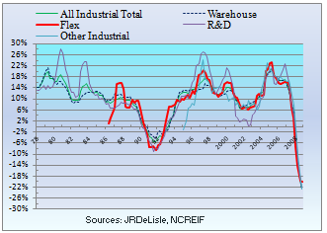
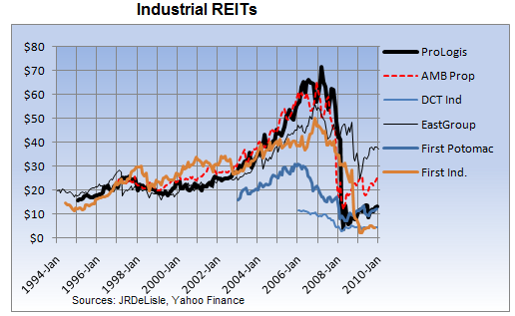
Industrial Real Estate
Opportunities
  Projects w/ Lost Tenants
  Capital Needs Projects
  Changing H&B Use
  Distressed Owners & REO
Overview
  Absorption tepid
  Vacancy rising
  Rents falling
  Continued Globalization
Notes:
The industrial market has continued the trend of slowing activity that characterized the first half of 2008. This easing was related to the softening economic picture in the U.S. and lower demand for space as manufactures pulled back on operations and capacity utilization declined. At the same time, the moderate weakening in fundamentals was exacerbated by the unexpected global recession which has dampened demand for exports, thus eliminating one of the anticipated drivers for the sector. For port markets and those along the primary distribution routes, the end result was negative absorption which hadn’t occurred for over five years and a moderate increase in vacancy rates. Due to the short pipeline for production of new space relative to other property types, development of new industrial space was scaled back, helping keep supply and demand in relative balance. Despite the general slowdown in the sector, new supply chain, logistical models and technological innovations create concern for obsolete product in weaker markets. Office showroom, flex and R&D space may also come under more price pressure as fundamentals weaken along with the broader economy. There are some opportunities in the current market, especially for projects in need of better management or additional capital. Opportunists might also benefit by focusing on sources of product likely to come under pressure as a result of REO or asset takeovers as investors seek higher returns or risk mitigation.

Slide 30
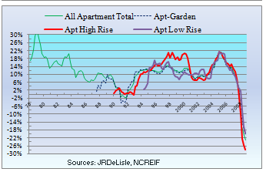

Multifamily Real Estate
Overview
  Rent vs. Own
  Affordable Housing
  Negative absorption
  Vacancy rates rising
  Rents down, concessions up
Opportunities
  Projects in pre-development
  Entitled but unfunded
  Repositioning
  Conversion (future)
  Distressed Owners & REO
Notes:
The apartment market is one of the brighter spots, with a number of markets experiencing a decline in vacancy rates and rising rents. This situation is a stark contrast to the single-family and condominium markets which are faced with significant excess capacity. The prospects of record foreclosures that would force homeowners on the street promise some upside potential for the apartment sector. However, the interventions and incentive programs that are being launched to provide some relief for borrowers and allow them to stay in their homes may dampen this potential surge in demand. On the other hand, the slowing economy and prolonged recovery of the single family market should bolster the ranks of renters and help stabilize rental rates. Some areas of concern relate to product with weak fundamentals or those that have no competitive advantage. At the same time, projects developed in anticipation of shifting consumer preferences (i.e., higher density) and normative desires (e.g., shared parking) may struggle. Opportunities include projects in the works or entitled that are now struggling for capital, as well as assets in need of repositioning or value creation. As with other property types, investors might also take advantage of the challenges faced by some owners/investors via channel sourcing of REO and assets held by undercapitalized investors.

Slide 31


Hotels
Overview
  Occupancy down
  Room rates down
  Revenues down
  Rising distress
Opportunities
  Projects abandoned
  Entitled: not started
  Reflagging existing
  Distressed Owners & REO
Notes:
From an institutional perspective, the hotel sector is characterized by the most volatile of all major property types. This is evidenced by the volatile return series reported in the NCREIF index. In the recent environment, the hotel sector is expected to experience a series of shocks as businesses, consumers and travelers cut back on hotel stays. Areas of particular concern are homogenized product that is poorly positioned in the market and properties with weak flags. There will be a number of opportunities including projects in development as well as projects that receive entitlements but have not yet started. As some chains are forced to cut back on supply, there may also be some opportunities to reflag existing hotels. Other opportunities may be harvested by focusing on sourcing particularly undercapitalized owners and institutional REO. Players with the wherewithal and expertise to manage hotels may also find some opportunities via asset takeovers as funds and investors are expected to struggle.

Slide 32



Part IV: The Seattle Real Estate Scene
Top Investments
Top Development
Recent slip
from top
Source: 2010 Emerging Trends

Slide 33

Seattle Cap Rates
Sources: JRDeLisle, IREM Survey Respondents
Notes:
The Seattle area respondents provided their crystal ball and current view of local cap rates. Interestingly, for core assets the current rates were around national averages, but respondents expected them to be 50-100bp higher in 12 months and reflect a much wider spread than the national averages in 3 years. Local distressed Cap Rates and national ones were generally in line although they did not think they were currently as bad as the national rates.

Slide 34


Seattle Transactions and Cap Rates vs. National?
Seattle Transaction Volume: 2009
Seattle Cap vs. National by Property Type
Not as different as we thought
Notes:
In many respects Seattleites tend to believe they are different from the rest of the market. In order to test this theory one can compare cap rates. As noted in the upper right graph the Rates and Seattle are not different from national capitalization rates plotted by property type. While property crimes have fallen somewhat across the country, the top markets which includes Seattle has fared better than the average. Although Seattle comes out higher rankings, this divergence is unlikely to hold suggesting Seattle isn’t for some repricing for core commercial real estate.

Slide 35



Seattle Distressed Asset Profile
Outlook……

Slide 36


Distressed Assets in Seattle
Total Dollars (millions)
A Relative Picture

Slide 37



Housing Price Index: Seattle MSA
FHFA
Index
Case-Shiller
Housing Index

Slide 38
Implications for Seattle?
Key Success Factor: Patience & Collaboration
  Buyers & sellers not adjusted
  Relationships and commitments strained
Players
  Some will drop out
  Some will be shaken out or forced out
  Some will swoop in
Activities
  Development frozen
  Entitlement push, follow-through drag
Projects
  Focus on Green (economics)
  Innovative & forward looking stalled
Source: DeLisle November Survey:
Washington State Commercial Association of REALTORS®
Notes:
While my presentation and our discussion has been on the negative side of the equation for understandable reasons, some of the respondents did see some opportunities in Seattle. With respect to property types, the greatest opportunities for an apartment and industrial, along with renovation or rehabilitation of existing product. The respondents continued like locations including TOD, infill sites such as Queen Anne and South Lake Union. They also realize real estate service providers will be busy with the tenant representatives having the most fun. Investors who are flush with cash will likely see some opportunistic buys, although sellers are not there yet. Finally, the respondents focused on the word “distressed” and opportunities in buying anything distressed as you can get the pricing right, which may be somewhat premature.

Slide 39

Reflecting on the Future…..
So, we’ll be “Leaner, meaner, cleaner and greener”
Will you be in the game or on the sidelines?
Reflecting on the Future…
  Experience, critical thinking and survival instincts will rule…
  If you don’t have that, there’s always school…
http://jrdelisle.com
Notes:
In the current stage of the real estate cycle, many difficult decisions will have to be made. Some will be focused on expanding wealth, while others will be focused on damage control and survival. During this period, being connected to the rapidly changing markets, and having solid on-going relationships will be more important than ever. To help, I will try to stay on top of the unfolding scene and, where possible, try to get ahead of the curve. I offer my personal website http://jrdelisle.com with more features to come including an AskDrD interactive element. My full text articles on Financial Views dating back 10 years are also available in the Market Watch section. Good luck and thanks for the opportunity to share my thoughts and to stay connected via the survey and audience feedback.

